Slide 1
PRESS RELEASE
GHANA PRODUCER PRICE INDEX AND INFLATION
JULY 2023
16th AUGUST 2023

Slide 2
In this release, we present:
Definition and Measurement of the Producer Price Index (PPI)
Producer Price Index and Producer Inflation for July 2023
Disaggregation of the July 2023 Producer Inflation
Highlights of July 2023 Producer Inflation

Slide 3
Definition and Measurement of PPI and Inflation (1/2)
The Producer Price Index (PPI) measures the average change over time in the selling prices of goods and services as received by domestic producers.
Price collected for the computation of PPI are known as factory gate prices, which are the prices firms assign to their products.
These prices exclude sales and excise taxes, government subsidies other costs incurred by other intermediaries and consumers
The rate of Producer Inflation is the relative change in PPI between periods

Slide 4
Definition and Measurement of PPI and Inflation (2/2)
PPI computation is based on a fixed basket of products.
Firms are the primary source of data
Firms are selected based on the Integrated Business Establishment Survey
Variables for the computation of PPI are weights, prices, quantities and products.
Two reference periods for the computation of PPI are the weight reference (industry and product shares) and the index reference for price comparison.
The computation is done from a dual time perspective, monthly and annually

Slide 5
Reference Periods - PPI and Inflation
Weight Reference-2019
Weight reference at the industry level is based on 2019 Gross Value Output (GVO)
Selection of firms is based on the Integrated Business Establishment Survey (II)
Index Reference (Price Comparison)– March 2020 to February 2021 =100

Slide 6
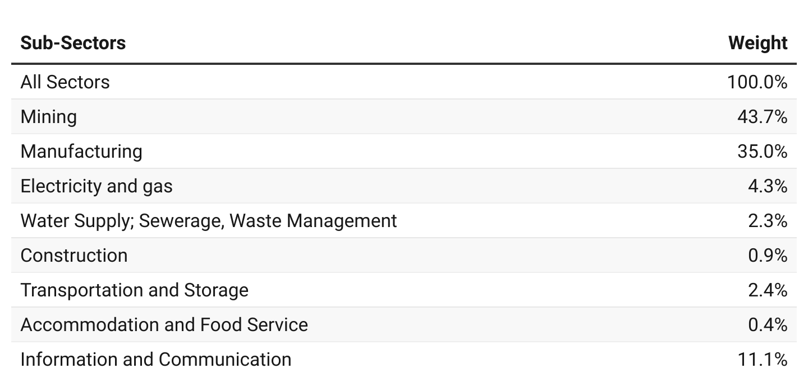
PPI Weights

Slide 7
Producer Price Index and Producer Inflation for July 2023
Year-on-year inflation rate at factory prices for all goods and services was 32.7 % in July 2023.
The monthly producer inflation rate was 0.8%.
Month | PPI (03/2020-02/2021 =100) | Inflation
 |  | Monthly | Yearly
June 2023 | 194.7 | 0.6 | 29.2
July 2022 | 147.8 | -1.9 | 37.1
July 2023 | p196.3 | p0.8 | p32.7
p = provisional

Slide 8
Disaggregation of the June and July 2023 Producer Inflation by Sectors

Slide 9
Disaggregation of the July 2023 Producer Inflation by Sub-Sectors

Slide 10
Change in Sub-Sector Producer Inflation for July 2023

Slide 11
Producer Inflation for Manufacturing Sub-Sector for July 2023

Slide 12
Producer Inflation for Mining and Quarrying Sub-Sector for July 2023

Slide 13
Producer Inflation for Construction Sub-Sector for July 2023

Slide 14
Producer Inflation for Services Sub-Sector for July 2023

Slide 15
Highlights (1/2)
28.0%
Manufacturing
38.9 %
Mining and quarrying
35.7 %
Industry
69.6%
Electricity and gas
32.7%
July 2023 yearly Producer Inflation
38.5%
Water supply, sewerage and waste management
29.2%
June 2023 yearly Producer Inflation
17.0%
Service
46.0 %
Transport and storage
18.5%
Construction
35.0 %
Accommodation and food
11.1%
Information and communication

Slide 16
Highlights (2/2)
1.6 %
Mining and quarrying
0.3%
Manufacturing
0.9 %
Industry
0.0%
Electricity and gas
0.0%
Water supply, sewerage and waste management
0.0%
Service
0.8 %
July 2023 monthly Producer Inflation
0.1 %
Construction
0.0 %
Transport and storage
0.6 %
June 2023 monthly producer inflation
0.7%
Accommodation and food
-0.1%
Information and communication

Slide 17
THANK YOU End of Press Release for July 2023 Producer Price Index For enquiries, please contact: Mr. Anthony Krakah (Head, Business & Industrial Statistics, GSS) Anthony.krakah@statsghana.gov.gh

