Slide 1
PRESS RELEASE
GHANA PRODUCER PRICE INDEX AND INFLATION
MAY 2023
21ST JUNE 2023

Slide 2
In this release, we present:
Definition and Measurement of the Producer Price Index (PPI)
Producer Price Index and Producer Inflation for May 2023
Disaggregation of the May 2023 Producer Inflation
Highlights of May 2023 Producer Inflation

Slide 3
Definition and Measurement of PPI and Inflation (1/2)
The Producer Price Index (PPI) measures the average change over time in the selling prices of goods and services as received by domestic producers.
Price collected for the computation of PPI are known as factory gate prices, which are the prices firms assign to their products.
These prices exclude sales and excise taxes, government subsidies other costs incurred by other intermediaries and consumers
The rate of Producer Inflation is the relative change in PPI between periods

Slide 4
Definition and Measurement of PPI and Inflation (2/2)
PPI computation is based on a fixed basket of products.
Firms are the primary source of data
Firms are selected based on the Integrated Business Establishment Survey
Variables for the computation of PPI are weights, prices, quantities and products.
Two reference periods for the computation of PPI are the weight reference (industry and product shares) and the index reference for price comparison.
The computation is done from a dual time perspective, monthly and annually

Slide 5
Reference Periods - PPI and Inflation
Weight Reference-2019
Weight reference at the industry level is based on 2019 Gross Value Output (GVO)
Selection of firms is based on the Integrated Business Establishment Survey (II)
Index Reference (Price Comparison)– March 2020 to February 2021 =100

Slide 6
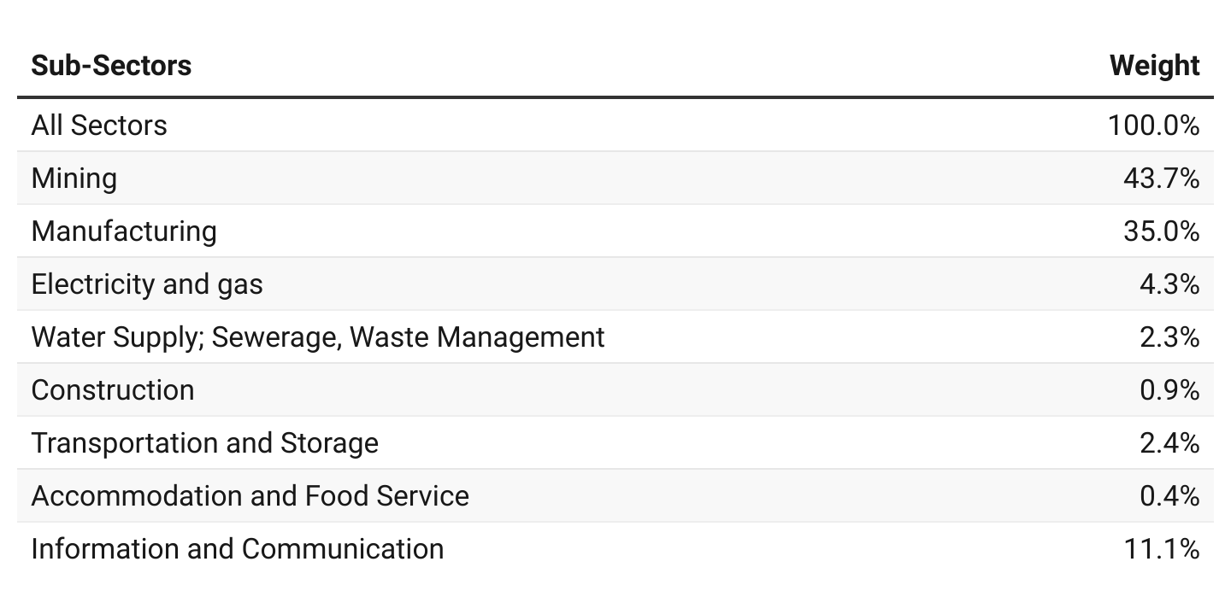
PPI Weights

Slide 7
Producer Price Index and Producer Inflation for May 2023
Year-on-year inflation rate at factory prices for all goods and services was 30.3 % in May 2023.
The monthly producer inflation rate was -2.7%.
Month | PPI (03/2020-02/2021 =100) | Inflation
 |  | Monthly | Yearly
Apr. 2023 | 198.8 | 2.8 | 34.3
May 2022 | 148.5 | 0.4 | 41.5
May 2023 | p193.5 | p-2.7 | p30.3
p = provisional

Slide 8
Disaggregation of the Apr. and May 2023 Producer Inflation by Sectors

Slide 9
Disaggregation of the May 2023 Producer Inflation by Sub-Sectors

Slide 10
Change in Sub-Sector Producer Inflation Apr. Vs. May 2023

Slide 11
Producer Inflation for Manufacturing Sub-Sector for Apr. and May 2023

Slide 12
Producer Inflation for Mining and Quarrying Sub-Sector for Apr. and May 2023

Slide 13
Producer Inflation for Construction Sub-Sector for Apr. and May 2023

Slide 14
Producer Inflation for Services Sub-Sector for Apr. and May 2023

Slide 15
Highlights (1/2)
25.5%
Manufacturing
36.5 %
Mining and quarrying
32.5 %
Industry
34.3%
April 2023 yearly Producer Inflation
51.8%
Electricity and gas
31.7%
Water supply, sewerage and waste management
30.3%
May 2023 yearly Producer Inflation
18.1%
Service
50.7 %
Transport and storage
20.0%
Construction
51.0 %
Accommodation and food
11.2%
Information and communication

Slide 16
Highlights (2/2)
-6.3 %
Mining and quarrying
0.8%
Manufacturing
-3.0 %
Industry
2.8 %
April 2023 monthly producer inflation
-0.1%
Electricity and gas
0.0%
Water supply, sewerage and waste management
-0.9%
Service
-2.7 %
May 2023 monthly Producer Inflation
0.0 %
Construction
-0.1 %
Transport and storage
1.0%
Accommodation and food
-1.1 %
Information and communication

Slide 17
THANK YOU End of Press Release for May 2023 Producer Price Index For enquiries, please contact: Mr. Anthony Krakah (Head, Business & Industrial Statistics, GSS) Anthony.krakah@statsghana.gov.gh

