Slide 1
PRESS RELEASE
GHANA, SEPTEMBER 2024
PRODUCER PRICE INDEX AND INFLATION
16th October 2024

Slide 2
In this release, we present:
Definition and Measurement of the Producer Price Index (PPI)
Producer Price Index and Producer Inflation for September 2024
Disaggregation of the September 2024 Producer Inflation
Highlights of September 2024 Producer Inflation

Slide 3
Definition and Measurement of PPI and Inflation (1/2)
The Producer Price Index (PPI) measures the average change over time in the selling prices of goods and services as received by domestic producers.
Prices collected for the computation of PPI are known as factory gate price, which are the prices firms assign to their products.
These prices exclude sales and excise taxes, government subsidies other costs incurred by other intermediaries and consumers
The rate of Producer Inflation is the relative change in PPI between periods

Slide 4
Definition and Measurement of PPI and Inflation (2/2)
PPI computation is based on a fixed basket of products.
Firms are the primary source of data
Firms are selected based on the Integrated Business Establishment Survey
Variables for the computation of PPI are weights, prices, quantities of products.
Two reference periods for the computation of PPI are the weight reference (industry and product shares) and the index reference for price comparison.
The computation is done from a dual time perspective, monthly and annually

Slide 5
Reference Periods - PPI and Inflation
Weight Reference-2019
Weight reference at the industry level is based on 2019 Gross Value Output (GVO)
Selection of firms is based on the 2013 Integrated Business Establishment Survey (II)
Index Reference (Price Comparison)– March 2020 to February 2021 =100

Slide 6
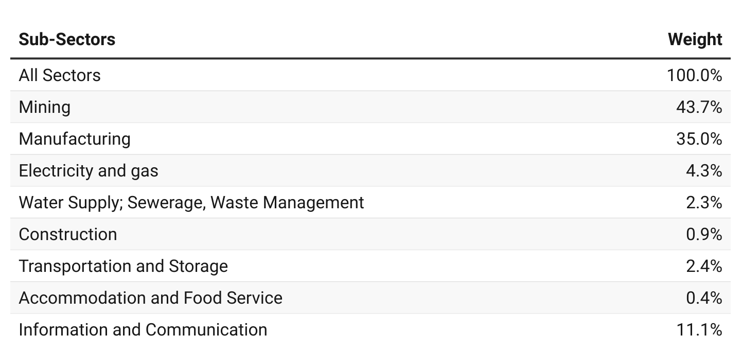
PPI Weights

Slide 7
Producer Price Index and Producer Inflation for September 2024
PPI for September 2024 was 261.4 relative to 200.5 for September 2023
Year-on-year inflation rate at ex-factory prices for all goods and services was 30.4% in September 2024.
Month-on-month producer inflation rate was 0.6%.

Slide 8
Disaggregation of the YoY August and September 2024 Producer Inflation by Sectors

Slide 9
Disaggregation of the September 2024 Producer Inflation by Sub-Sectors

Slide 10
Inflation of Sub-groups within the Construction Sub-Sector for September 2024
PPI release
Sept. 2024

Slide 11
Inflation of Sub-groups within the Mining and Quarrying Sub-Sector for September 2024

Slide 12
Sub-groups within the Manufacturing sub-sector with inflation rates above the sub-sector rate

Slide 13
Producer Inflation for Services Sub-Sector for September 2024

Slide 14
Highlights for September 2024 YoY Inflation
43.0%
Industry
48.7%
Mining and quarrying
4.0%
Water supply, sewerage and waste management
33.2%
Year-on-year
Producer Inflation
August 2024
21.8%
Manufacturing
12.3%
Service
30.4%
Year-on-year Producer Inflation
September 2024
31.1%
Accommodation and food
10.4%
Electricity and gas
30.9%
Transport and storage
23.2%
Construction
8.1%
Information and communication

Slide 15
Highlights for September 2024 MoM Inflation
1.8 %
Industry
2.7 %
Month-on-month
producer inflation
August 2024
-0.3%
Manufacturing
1.9%
Water supply, sewerage and waste management
1.2%
Mining and quarrying
0.6 %
Month-on-month
Producer Inflation
September 2024
0.5%
Services
2.3%
Transport and storage
0.7%
Electricity and gas
1.3%
Accommodation and food
0.5 %
Construction
0.0%
Information and communication

Slide 16
THANK YOU End of Press Release for September 2024 Producer Price Index For enquiries, please contact: Dr. Anthony Kofi Krakah (Head, Business & Industrial Statistics, GSS) anthony.krakah@statsghana.gov.gh

