Slide 1
RELEASE OF
2023 DOMESTIC & OUTBOUND TOURISM SURVEY REPORTS
DOMESTIC SAME-DAY & OVERNIGHT VISITORS’ REPORTS
Presented by
Dr. Alhassan Iddrisu
Government Statistician
16th December 2025

Slide 2

Introduction(1/2)

Slide 3
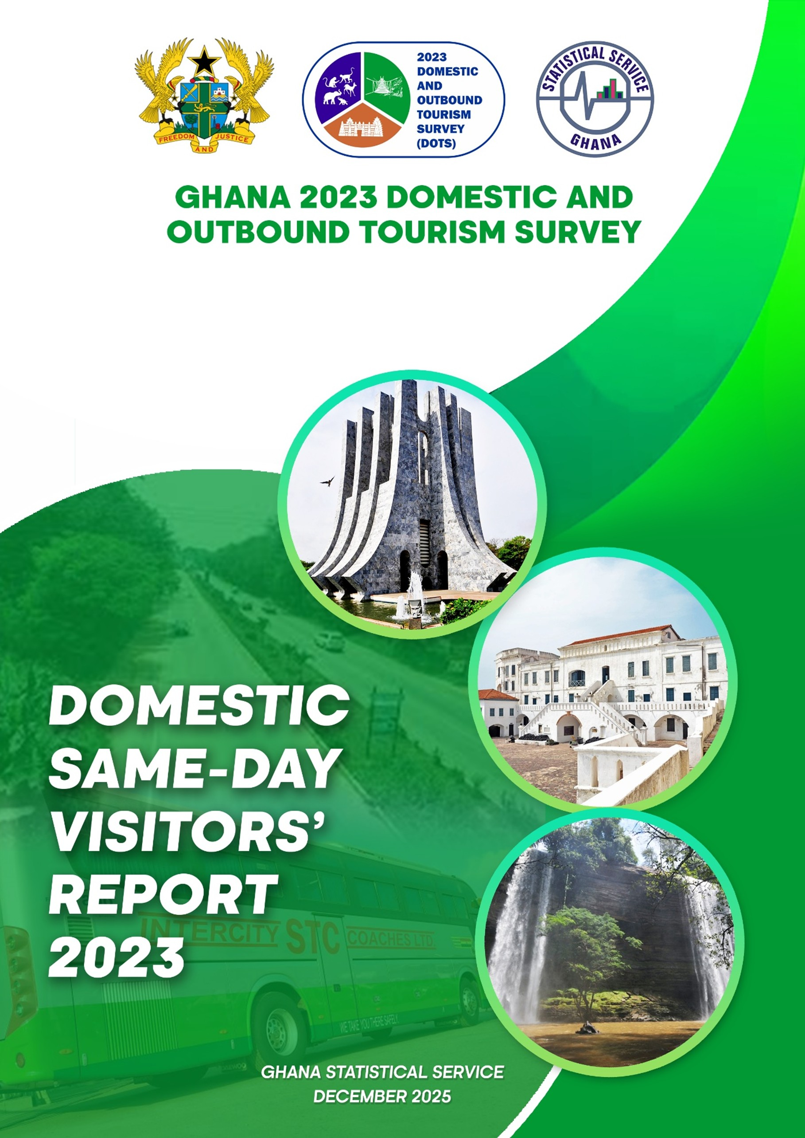

Cover Pages of Reports

Slide 4
Outline
Background/Objectives/Key Concepts
Methodology
Key Findings
Domestic Same-day Visitors
Domestic Overnight Visitors
Key Takeaways
Policy Recommendations

Slide 5
Background
1. Rationale of DOTS and Global Alignment
Provides data for Ghana’s tourism planning and is central to the development of the country’s first Tourism Satellite Account (TSA) which aims to quantify tourism’s impact on GDP.
Aligns with SDG Goal 8, Target 8.9, which promotes sustainable tourism, local culture, and products, with indicator 8.9.1 tracking tourism’s direct contribution to GDP and growth.
2. Tourism as a National Development Priority
15-Year Tourism Development Plan (2013–2027)

Slide 6
Objectives
The main objective is to obtain baseline data on domestic same-day and overnight visitors to enhance the development of Ghana’s tourism sector.
The specific objectives of the survey are to:
determine the profile and trip characteristics of domestic visitors;
provide baseline data to measure the volume and value of domestic visitors; and
estimate the expenditure of domestic visitors.

Slide 7
Methodology
Target Population: Ghanaian and non-Ghanaian residents who travelled within Ghana for tourism purposes during the reference period.
Sampling Design: Two-stage stratified systematic sampling procedure was adopted.
Stage 1: 740 Enumeration Areas (EAs) were selected.
Stage 2: 25 households per EA were selected (totaling 18,500 households).
Stratification: Based on 16 regions, each region was divided into urban and rural areas.
Sampling Unit: Households and individuals identified within the selected EAs.
Data Collection: Face-to-face interviews using Computer-Assisted Personal Interviewing (CAPI). Survey Instruments: included a listing form, household and individual questionnaires.

Slide 8
Concepts & Definitions (1/3)
CONCEPT | DEFINITION
DOMESTIC VISITOR | A resident of Ghana who travels outside his/her usual place of residence or usual environment for a period not exceeding 12 months and whose purpose of visit (business, leisure and other purposes) is other than the exercise of an activity remunerated from within the place visited in Ghana.
DOMESTIC SAME-DAY VISITOR | A resident of Ghana who does not spend a night during a trip outside his/her usual place of residence or usual environment and whose purpose of visit (business, leisure and other purposes) is other than engaging in an activity remunerated from within Ghana.
DOMESTIC OVERNIGHT VISITOR | A resident of Ghana who stays at least one night outside his/her usual place of residence or usual environment for a period not exceeding 12 months and whose purpose of visit (business, leisure and other purposes) is other than engaging in an activity remunerated from within Ghana.

Slide 9
Concepts & Definitions (2/3)
CONCEPT | DEFINITION
PACKAGE TOUR | A pre-arranged travel package that includes multiple components, such as accommodation, transportation, and other activities, put together by a tour operator or travel agency for a single price.
SELF-ARRANGED TOUR | It refers to travel arrangements made independently by the visitor without any assistance from a travel agent or tour operator.
REGION OF DESTINATION | This is the region where a visitor travels to for leisure, business, or other tourism-related purposes.
REGION OF ORIGIN | This is the region where a visitor normally resides before embarking on a trip for leisure, business, or other purposes.

Slide 10
Concepts & Definitions (3/3)
CONCEPT | DEFINITION
PRE-TRIP EXPENDITURE | All expenses on goods and services related to the tourism trip(s) made by visitors before the trip.
ON-TRIP EXPENDITURE | All expenses on goods and services related to the tourism trip(s) made by visitors during a trip.
POST-TRIP EXPENDITURE | All expenses on goods and services related to the tourism trip(s) made by visitors after the trip.

Slide 11
KEY FINDINGS

Slide 12
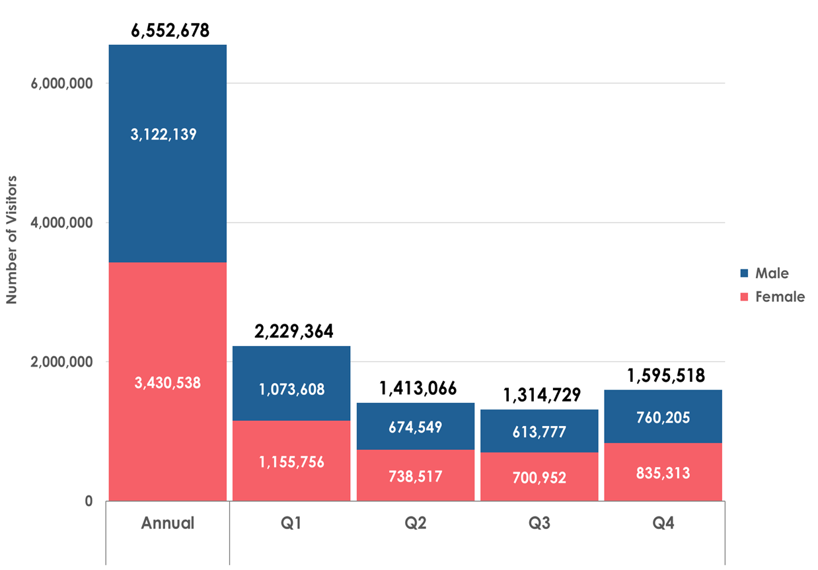
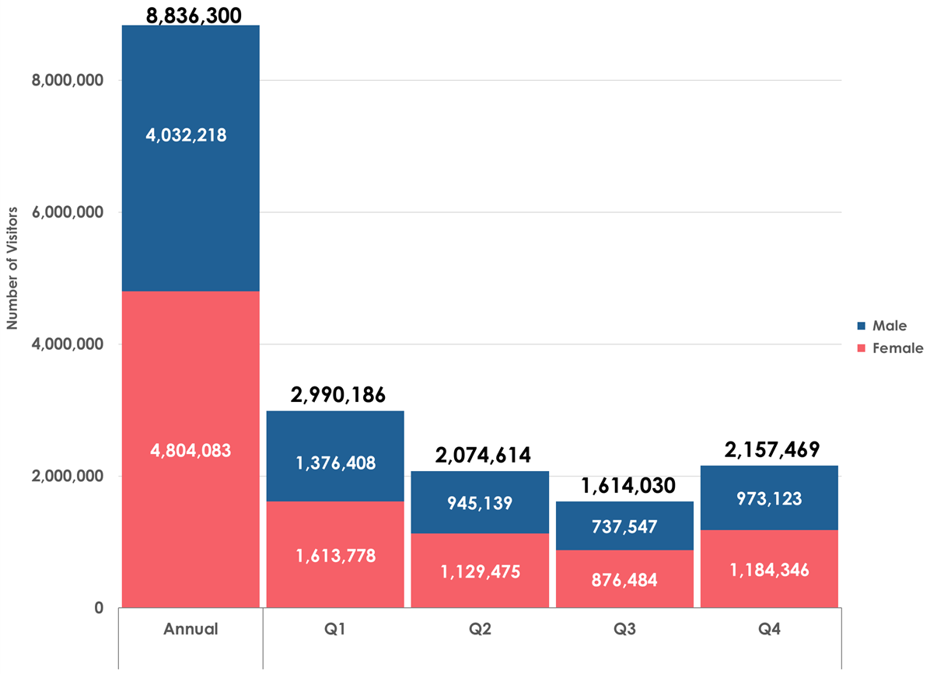
Number of Domestic Visitors
Total Domestic Visitors – 15,388,978
Same-day Visitors
Overnight Visitors

Slide 13
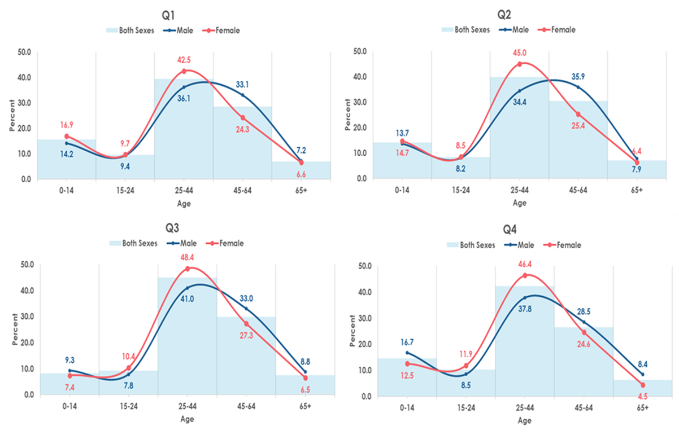
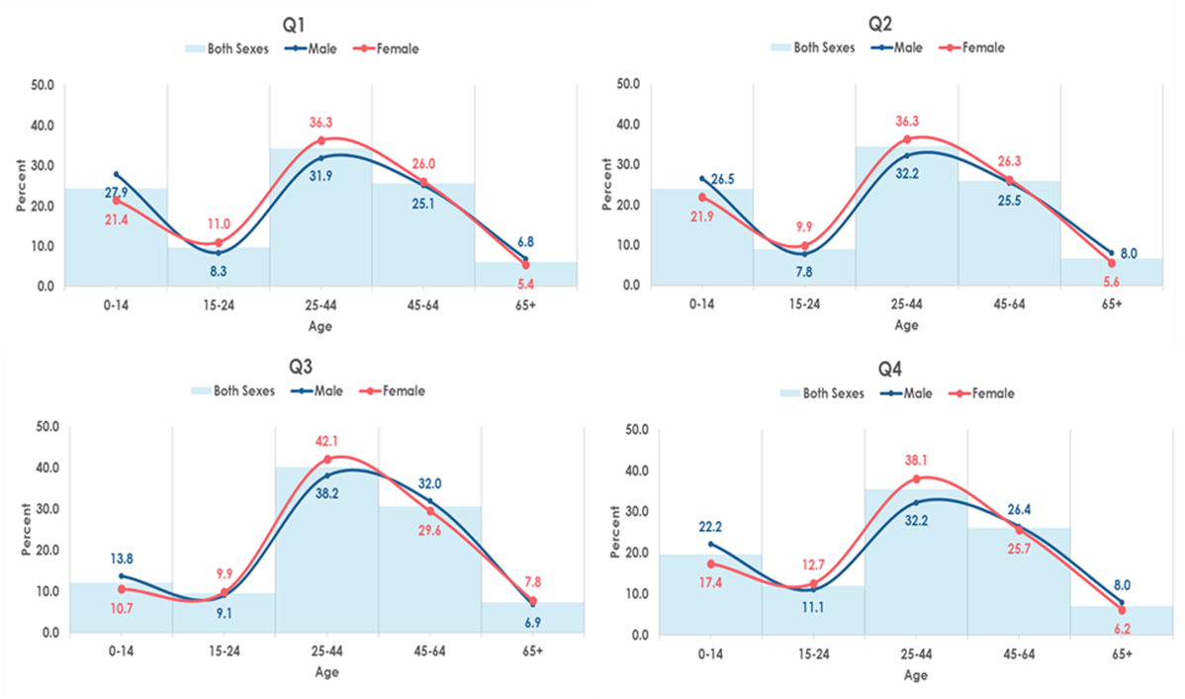
Age Distribution of Domestic Visitors by Sex
Adults (25-44 years) recorded the highest proportion of visitors each quarter
Same-day Visitors
Overnight Visitors

Slide 14
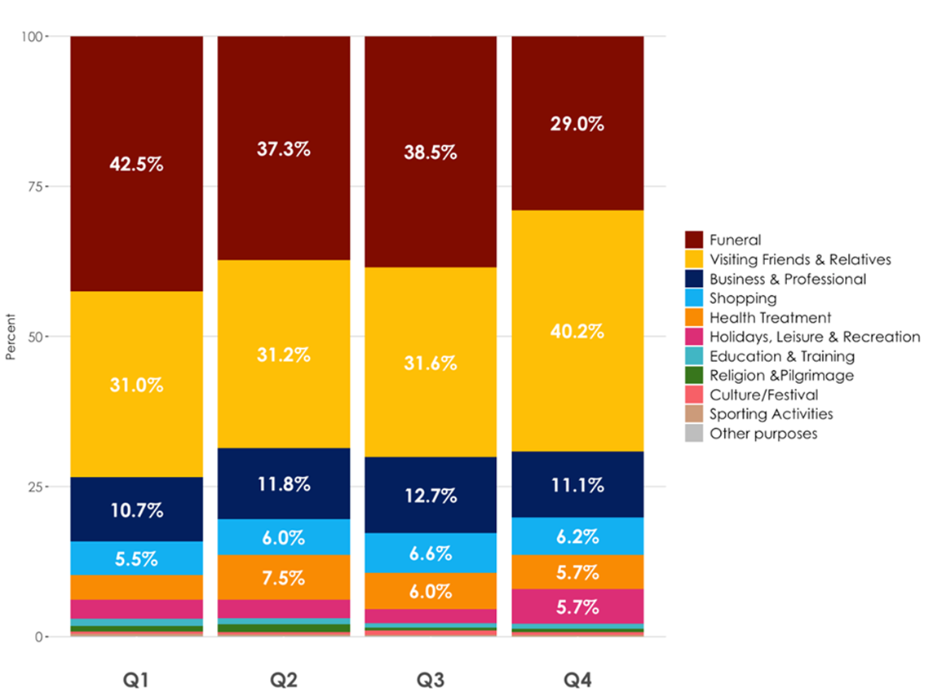
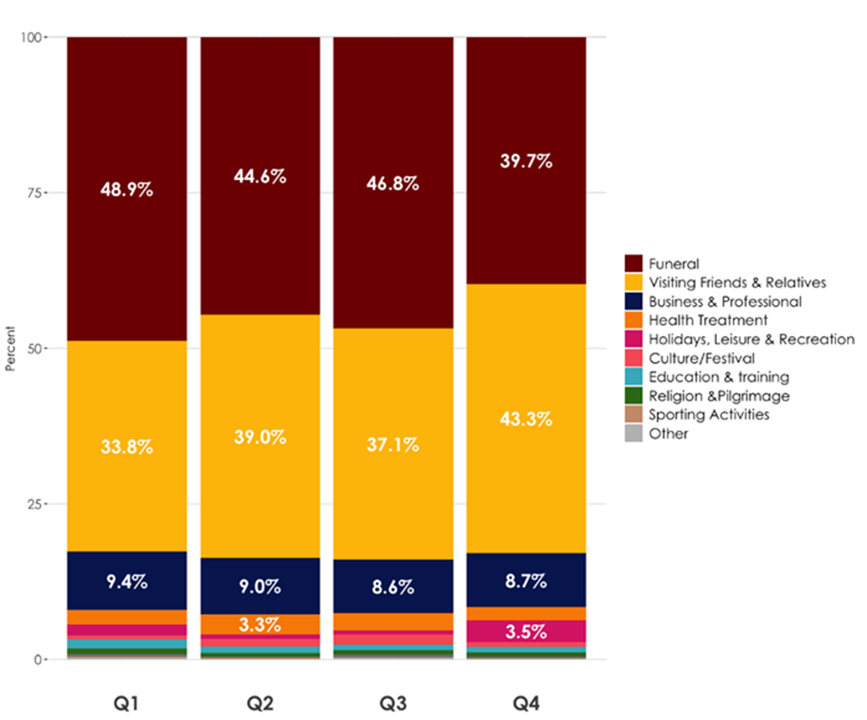
Domestic Visitors by Main Purpose of Visit
Visiting friends & relatives and funeral over 70% same day trips and 80% of overnight trips
Same-day Visitors
Overnight Visitors

Slide 15
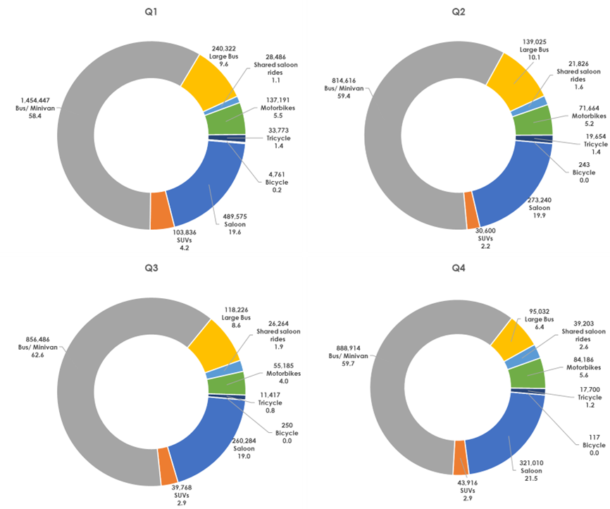
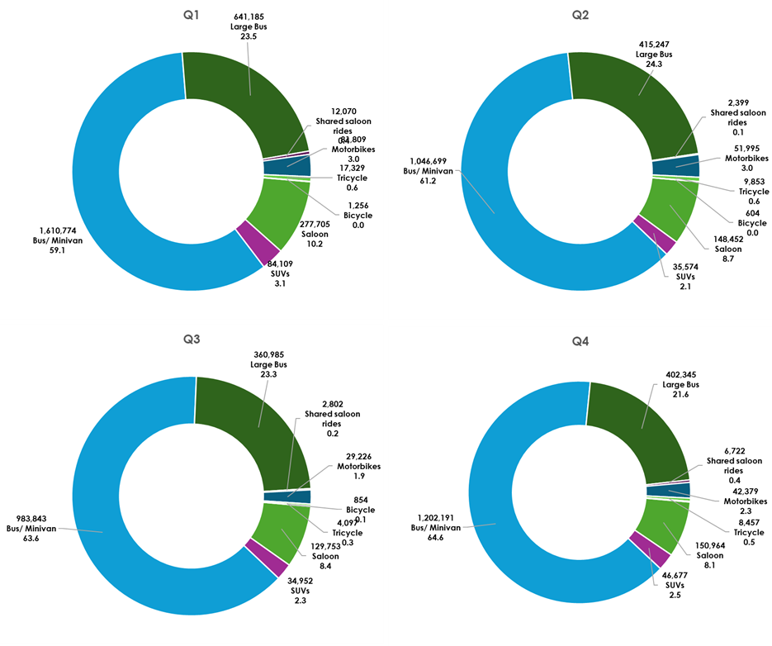
Domestic Visitors by Means of Road Transport
Same-day Visitors
Overnight Visitors
15

Slide 16
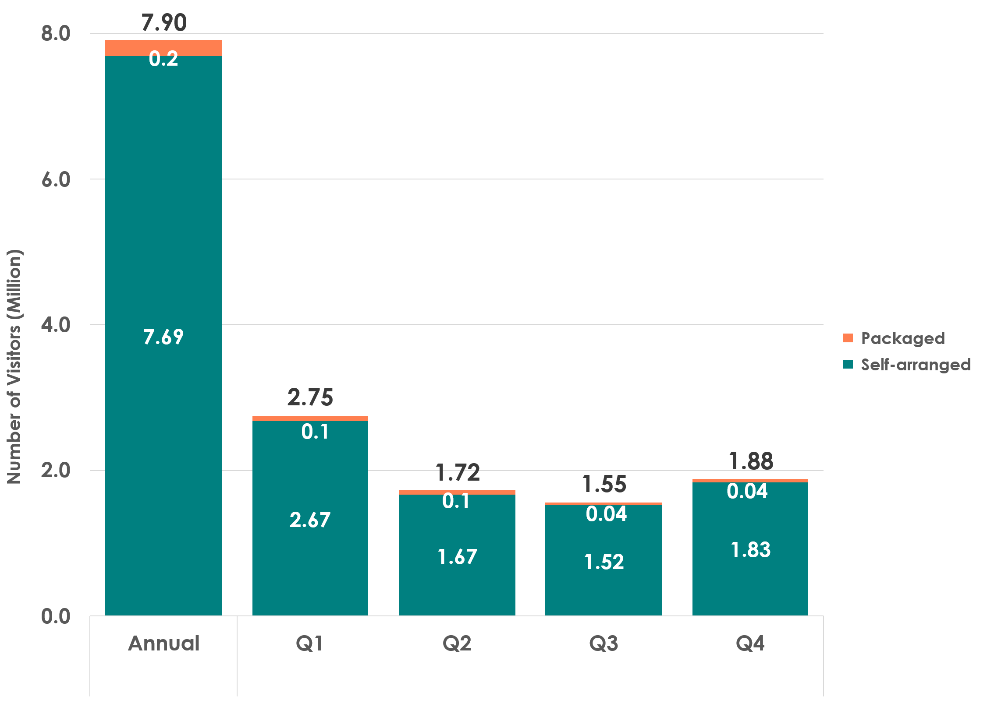
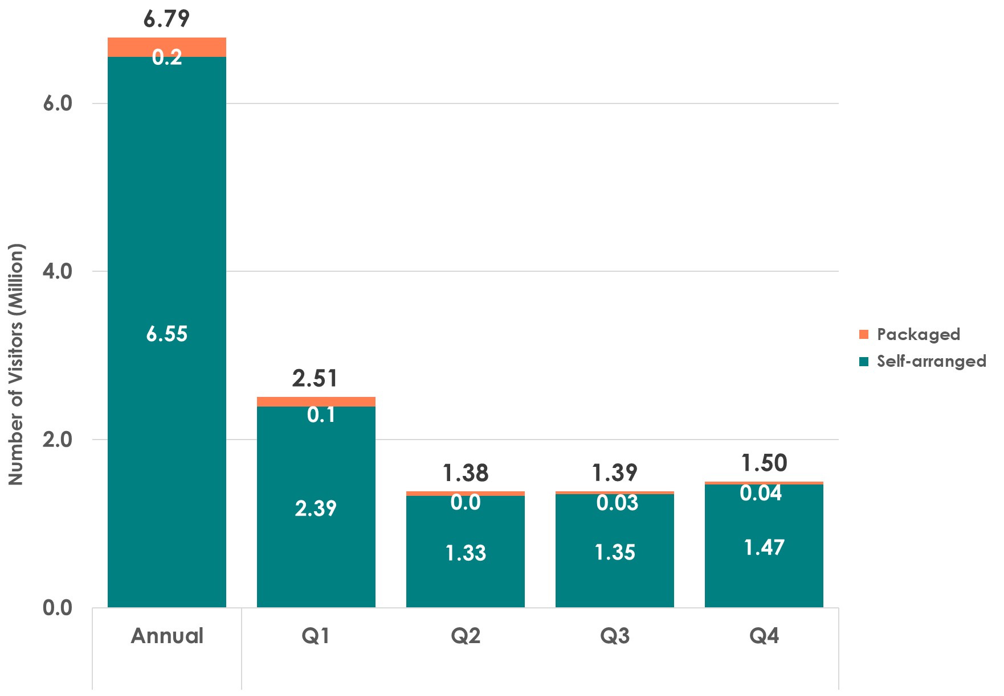
Domestic Visitors by Type of Tour
Same-day Visitors
Overnight Visitors
16

Slide 17
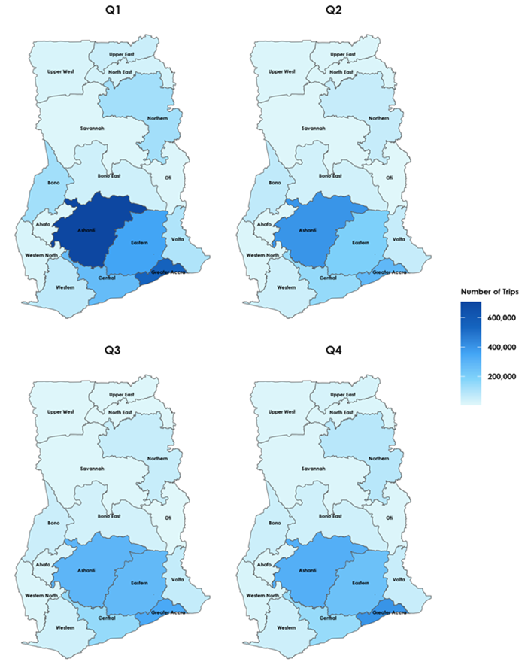
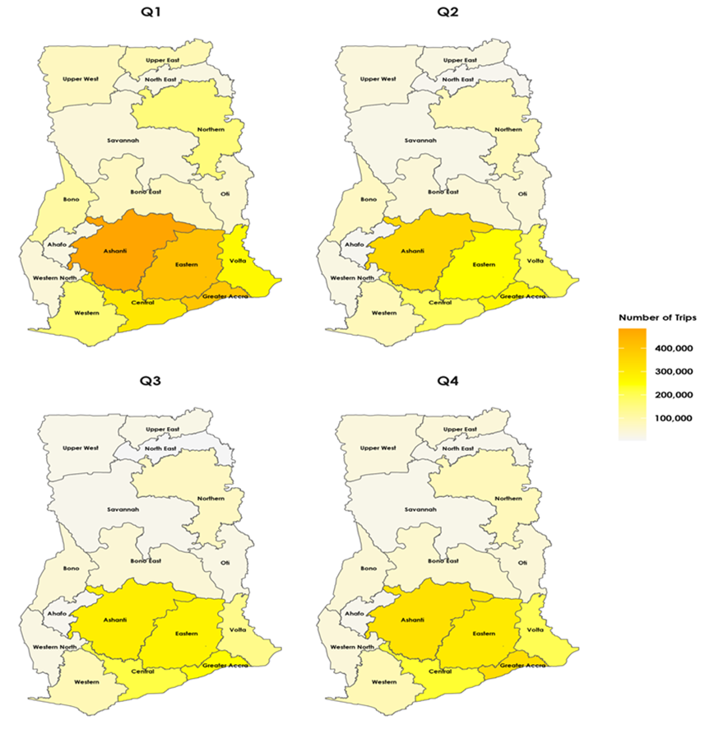
Domestic Visitors by Region of Destination
Ashanti and Greater Accra were the leading destinations for same-day trips while Ashanti, Eastern, and Greater Accra were the main destinations for overnight trips
Same-day Visitors
Overnight Visitors

Slide 18
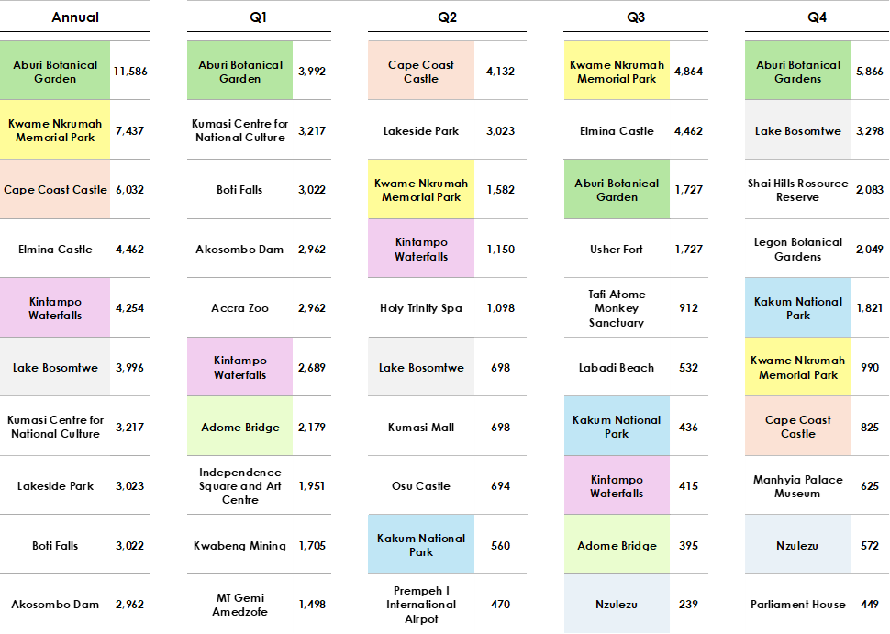
Top 10 Tourist Sites Visited by Domestic Same-day Visitors
18

Slide 19
Top 10 Tourist Sites Visited by Domestic Overnight Visitors
19

Slide 20
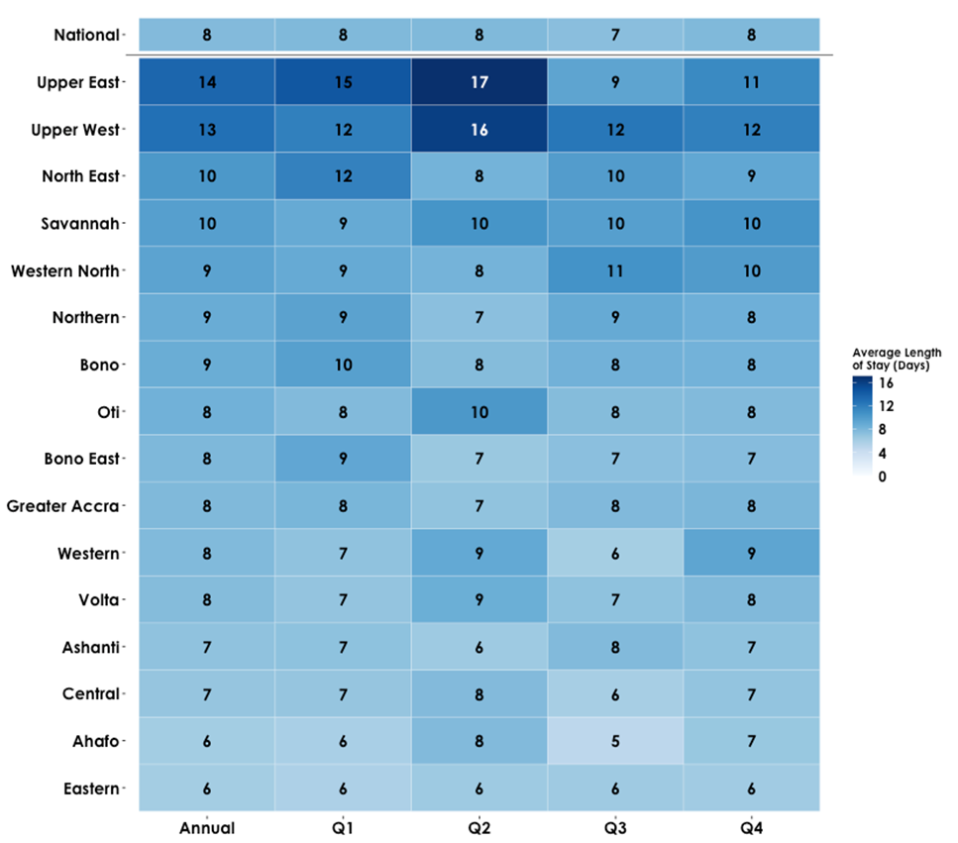


Average Length of Stay (Nights) of Domestic Overnight Visitors by Region of Visit
20

Slide 21
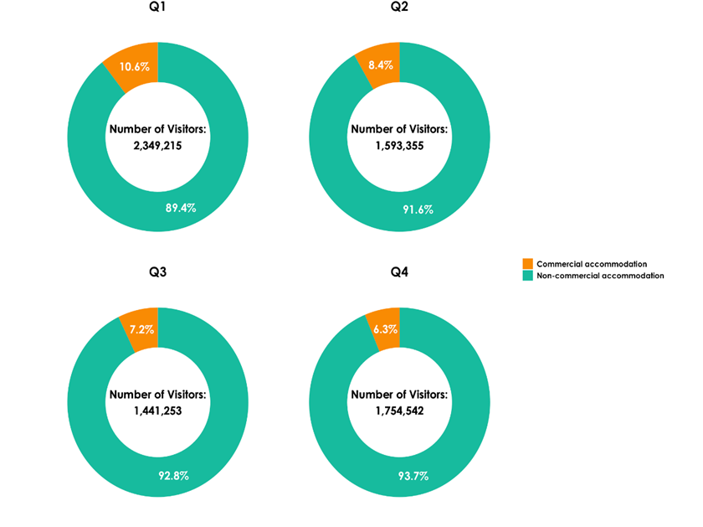
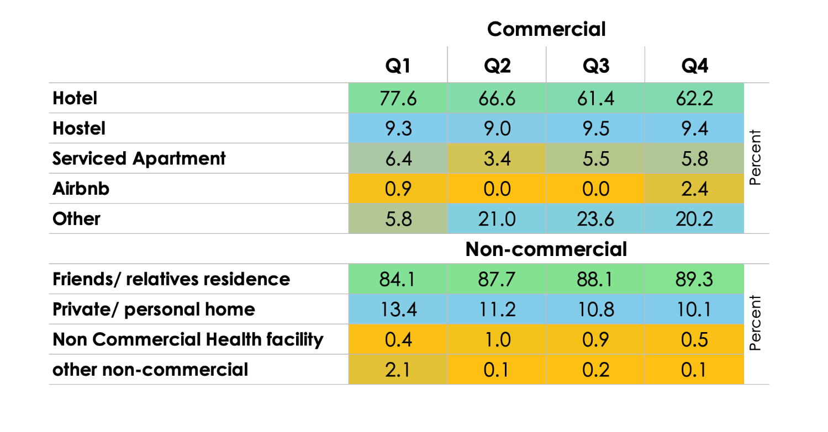
Domestic Overnight Visitors by Type of Accommodation Used

Slide 22
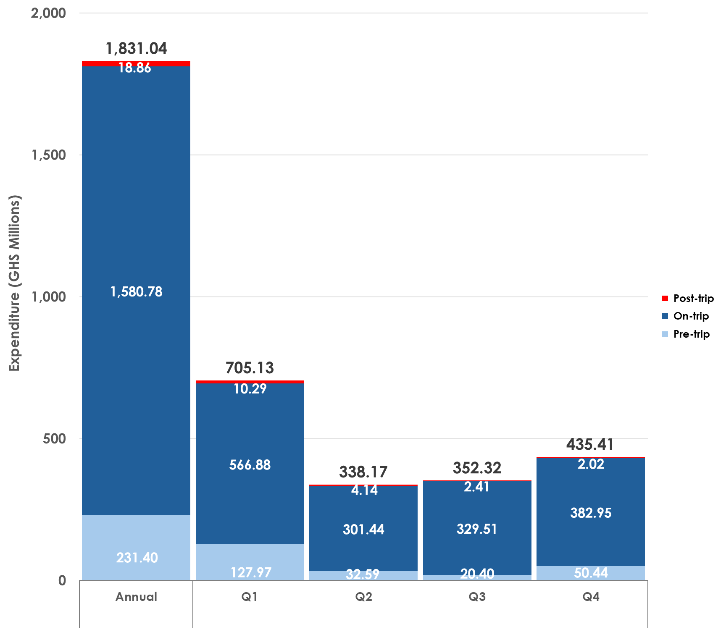
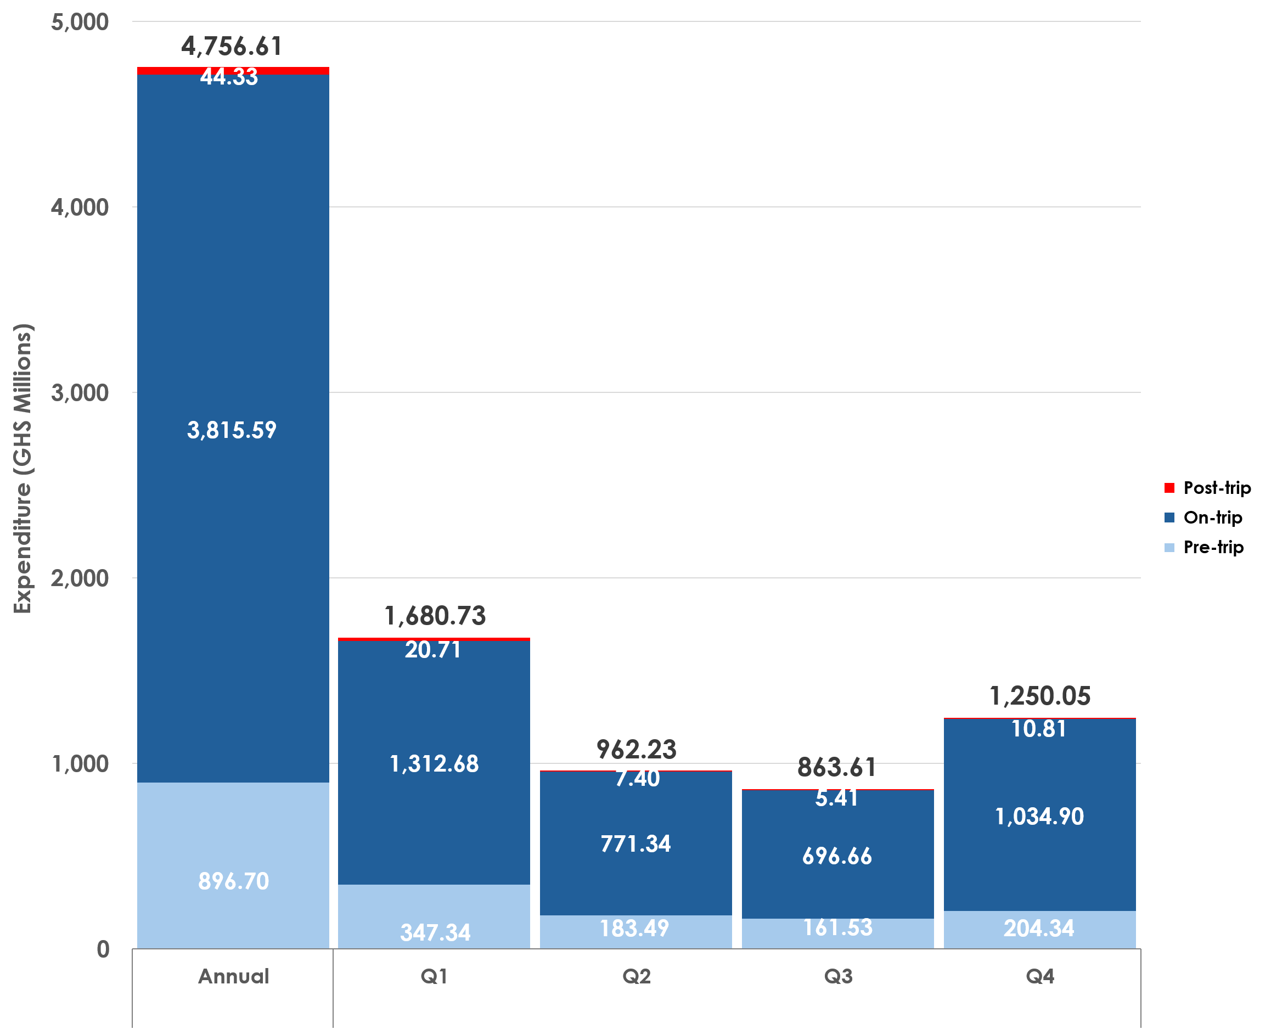
Expenditure of Domestic Visitors
Total Expenditure – GHS6.6 billion
Same-day Visitors
Overnight Visitors
22

Slide 23
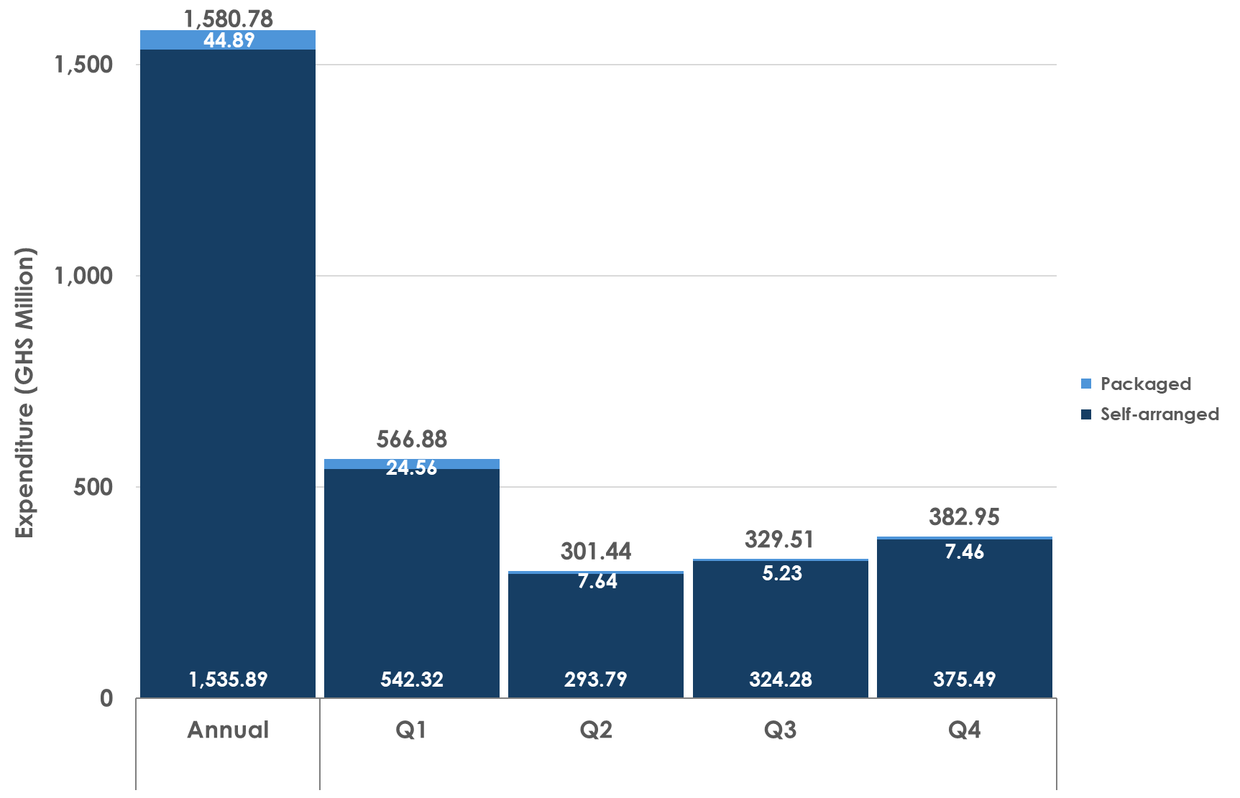
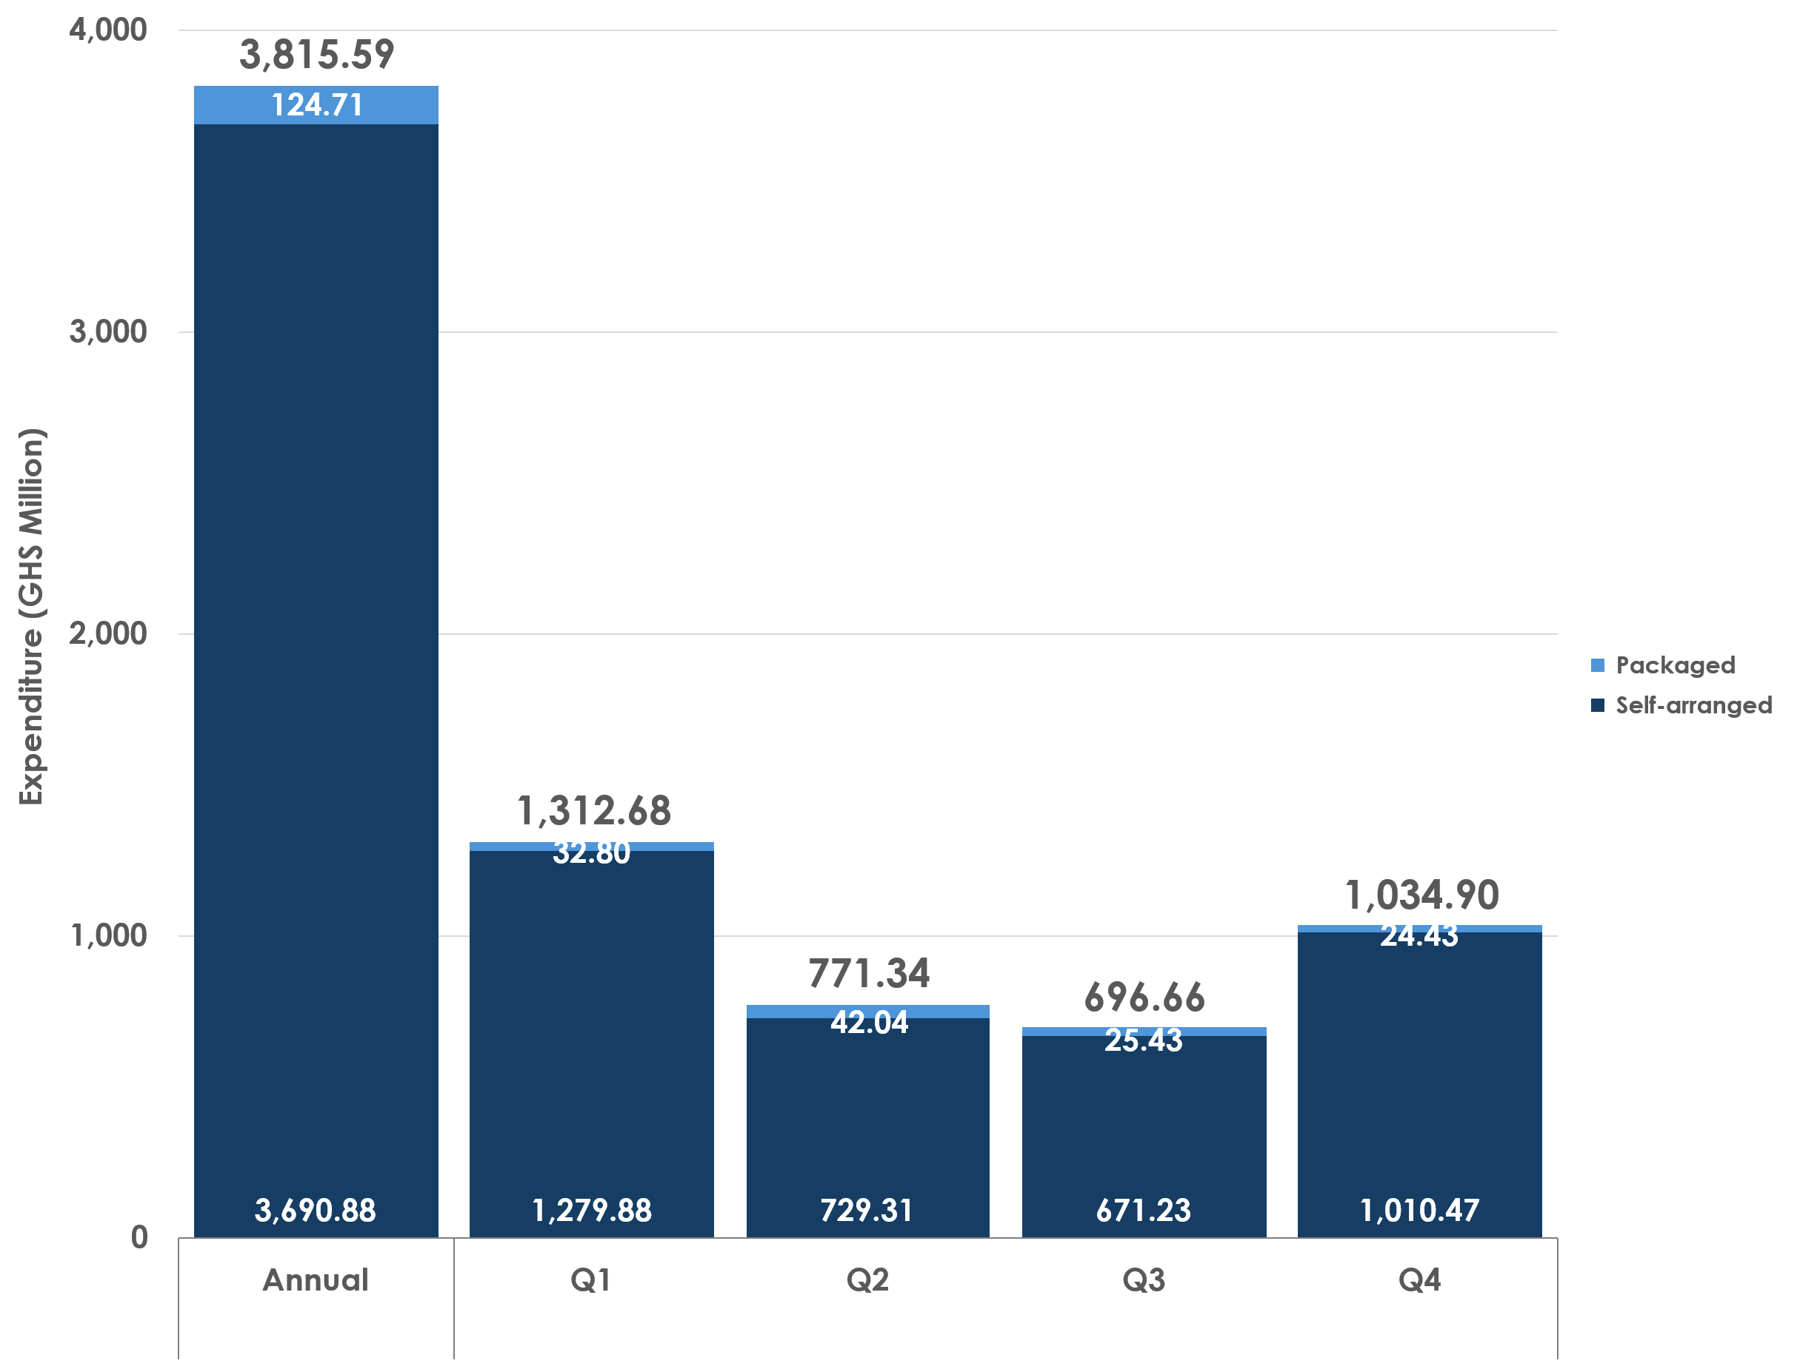
On-trip Expenditure of Domestic Visitors by Type of Tour
Same-day Visitors
Overnight Visitors
23

Slide 24
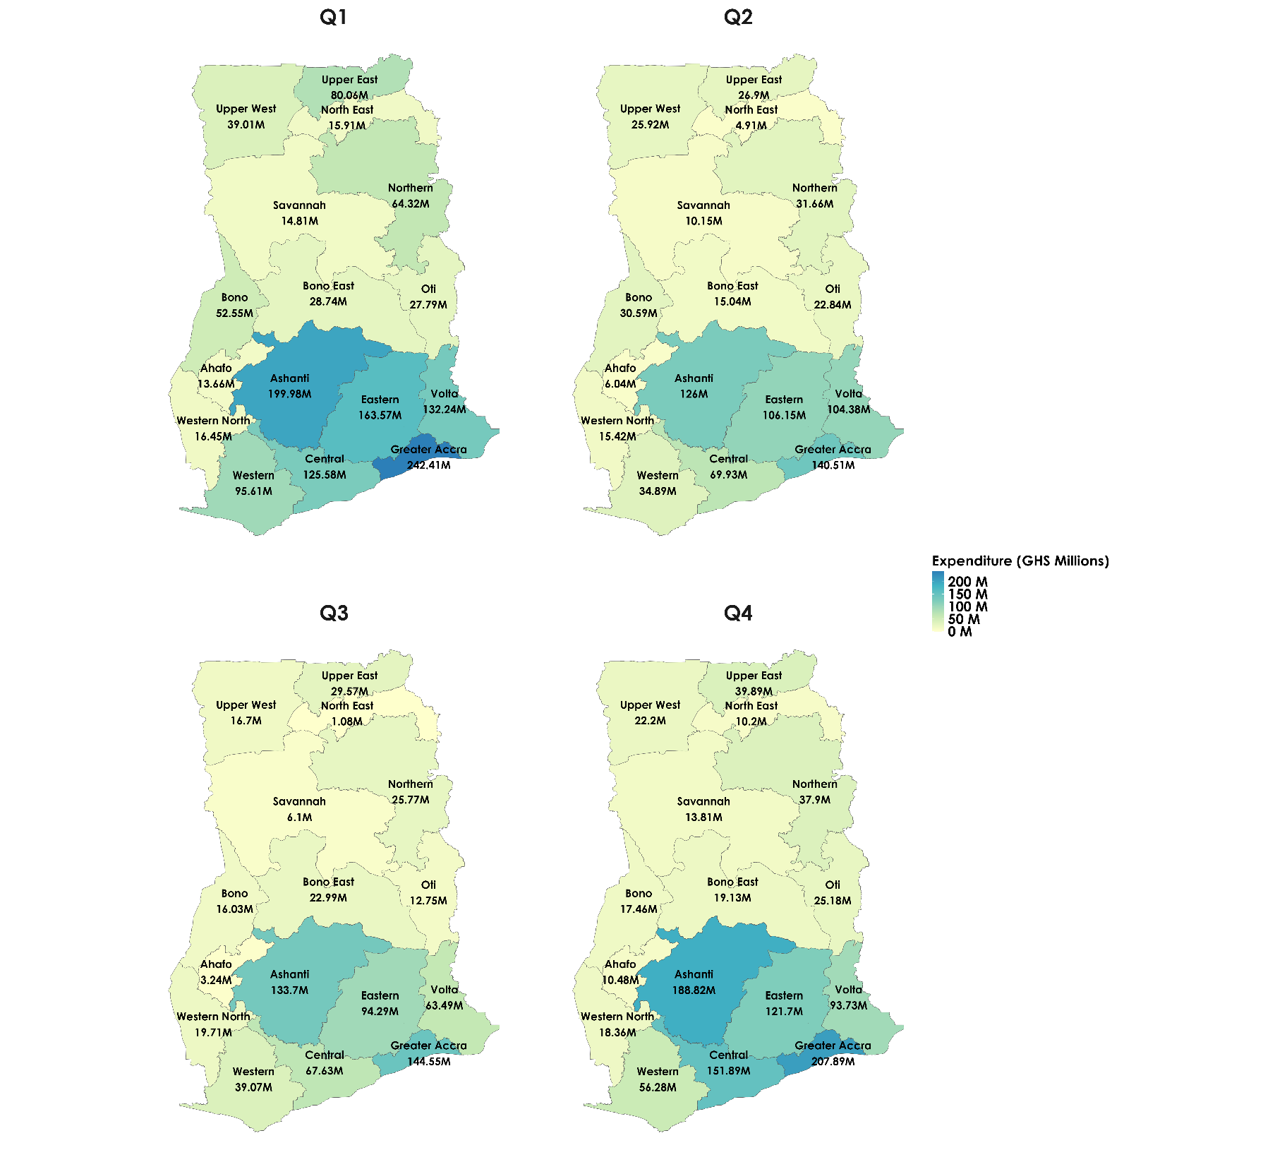
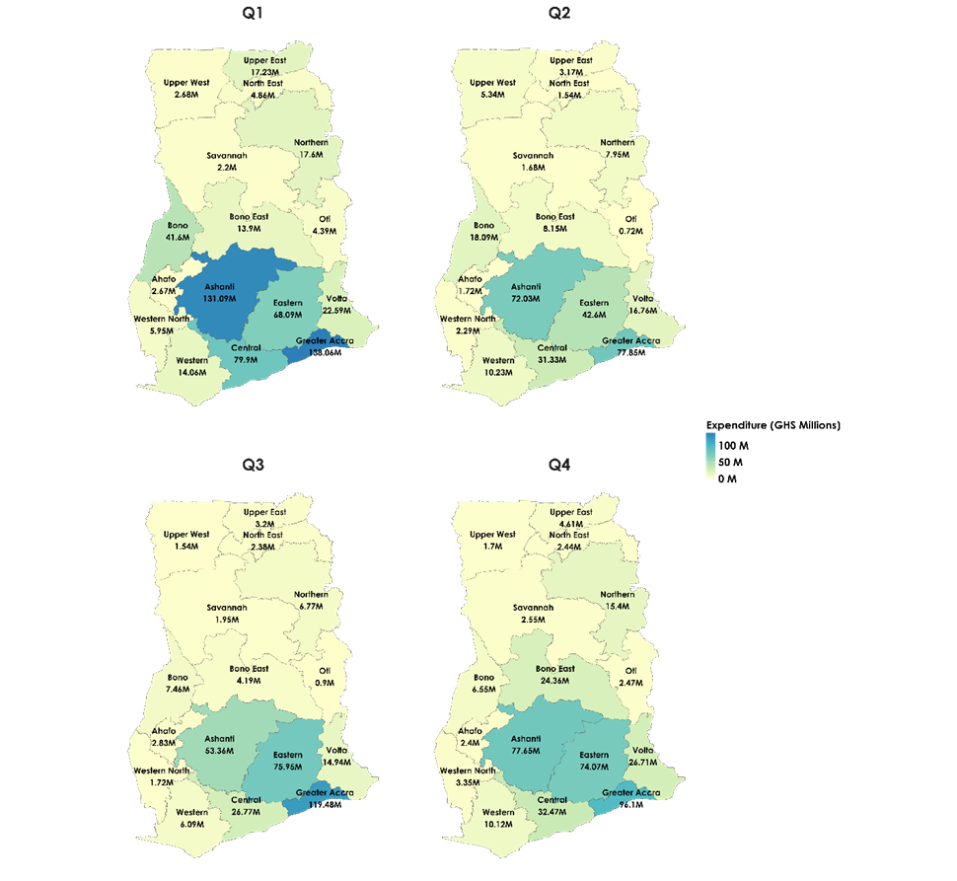
On-trip Expenditure of Domestic Visitors by Region of Visit
Same-day Visitors
Overnight Visitors
24

Slide 25
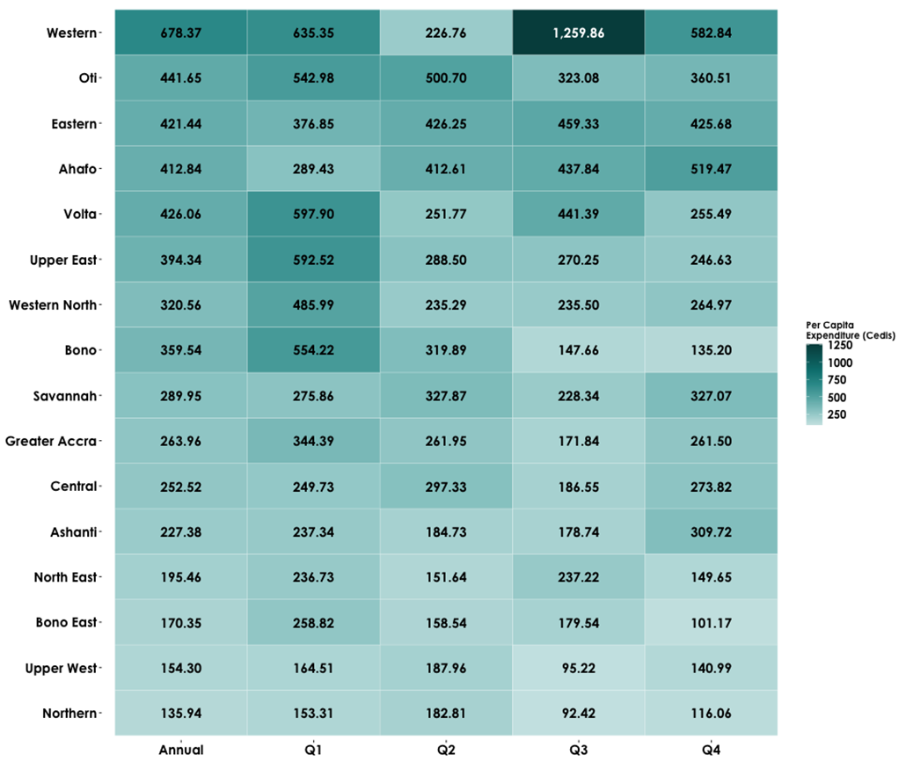
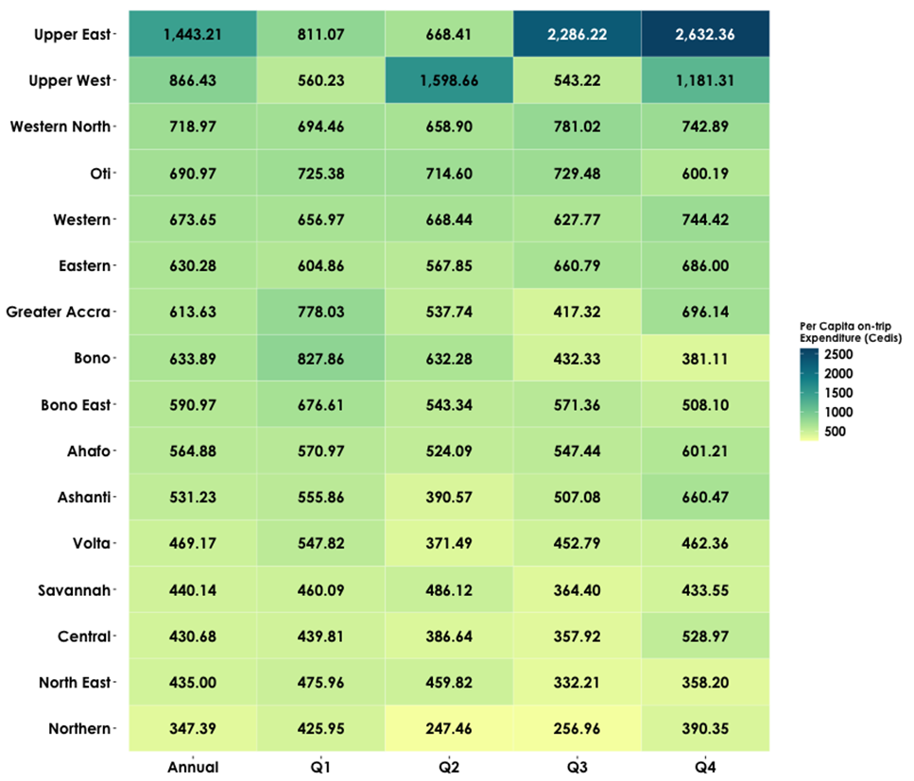
Per Capita On-trip Expenditure by Region of Origin (GHS)
Same-day Visitors
Overnight Visitors
25

Slide 26
Key Takeaways
Total domestic visitors were 15,388,978 with total expenditure of GHS 6.59 billion.
Domestic Same-day Visitors
Domestic Overnight Visitors
A total of 6.6 million domestic same-day visitors was recorded in 2023.
Domestic same-day visitors mainly travelled to visit friends and relatives and travelling for funerals.
Trips are concentrated in the southern part of Ghana, revealing uneven distribution of tourism benefits and opportunities.
Domestic same-day visitors’ expenditure was approximately GHS 1.83 billion in 2023.
A total of 8.8 million domestic overnight visitors was recorded in 2023.
Domestic overnight visitors mainly travelled to visit friends and relatives and travelling for funerals.
Trips are concentrated in the southern part of Ghana, revealing uneven distribution of tourism benefits and opportunities.
Domestic overnight visitors’ expenditure was approximately GHS 4.76 billion in 2023.

Slide 27
Policy Recommendations
Domestic tourism already works. The task now is to organise it, improve it, and let communities capture more value:
Fix the Roads People Already Use: Improve road quality, safety, signage, and rest facilities on major domestic travel routes. Improve service standards for buses and minibuses that carry most domestic travellers.
Let Local Economies Capture the Spend: Identify and support festivals, markets, heritage sites, social travel, accommodation, and other cultural businesses to keep local economies active day and night to retain spending where visitors already go.
Plan and Invest Using the Data: Integrate domestic tourism statistics into national and regional planning, the Tourism Satellite Account (TSA), and SME support programmes.
Build on Social Travel: Design tourism offerings around funerals and family visits by adding festivals, heritage stops, and short leisure add-ons during peak travel periods.
Convert Self-Arranged Trips into Value: Create simple, affordable products like day-trip bundles, guided visits, short retreats, transport-and-entry packages, digital booking through basic platforms, and local experiences that work for self-planned travellers.
Build capacity, strengthen community-based tourism, and promote inclusion.

Slide 28
Thank you for your attention
www.statsghana.gov.gh

