Slide 1
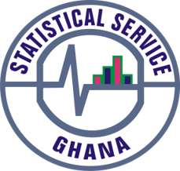
PRESS RELEASE
Ghana, February 2025
CONSUMER PRICE INDEX AND INFLATION
5th March 2025

Slide 2
In This Release, We Present:
Definition and Measurement of Consumer Price Index (CPI) and Rate of Inflation
CPI and Rate of Inflation for February 2025
Dominant Divisions of Rate of Inflation for February 2025
Disaggregation of Rate of Inflation for February 2025
Highlights of CPI and Rate of Inflation for February 2025
Item Level Price Changes for Wider National and Household Engagement
1

Slide 3
Definition and Measurement of CPI and Rate of Inflation (1/3)
CPI measures changes in the price of a fixed basket of goods and services purchased by households.
The assumption is that items in the basket are purchased each month, hence captures monthly price changes.
The rate of inflation is the relative change in CPI between periods
Inflation is reported year-on-year (annual inflation) and month-on-month (monthly inflation) and granulated to determine regional and commodity type and source of inflation.
2

Slide 4
Definition and Measurement of CPI and Rate of Inflation (2/3)
CPI does not measure price levels
The measures of CPI and inflation are based on the Consumer Price Index Manual: Concepts and Methods
Data (market readings) are captured monthly
Key variables are prices, quantities and expenditure weights of items
Price reference year for the new series is 2021 (2021 = 100)
Analyses of price changes of individual items for wider engagement
3

Slide 5
Definition and Measurement of CPI and Rate of Inflation (3/3)
Price collection is done in 57 markets
Prices are collected from about 8,337 outlets.
Prices are collected for approximately 47,800 products every month from 16 regions.
Products are ordered in a hierarchy of 13 Divisions, 44 Groups, 98 Classes, 156 Subclasses and 307 Items.
Every item can only be part of one Subclass, and every Subclass can only be part of one Class, etc.
4

Slide 6
Consumer Price Index and Rate of Inflation for February 2025
CPI for February 2025 was 255.9 relative to 207.8 for February 2024
Year-on-year rate of inflation for February 2025 was 23.1 percent
This means that in February 2025 the general price level was 23.1 percent higher than February 2024
Month-on-month inflation between January and February 2025 was 1.3 percent
Month | CPI | Inflation
 |  | Monthly | Yearly
Feb-2024 | 207.8 | 1.6% | 23.2%
Mar-2024 | 209.5 | 0.8% | 25.8%
Apr-2024 | 213.3 | 1.8% | 25.0%
May-2024 | 220.0 | 3.2% | 23.1%
Jun-2024 | 226.4 | 2.9% | 22.8%
Jul-2024 | 231.0 | 2.1% | 20.9%
Aug-2024 | 229.4 | -0.7% | 20.4%
Sep-2024 | 235.8 | 2.8% | 21.5%
Oct-2024 | 237.8 | 0.9% | 22.1%
Nov-2024 | 243.9 | 2.6% | 23.0%
Dec-2024 | 248.3 | 1.8% | 23.8%
Jan-2025 | 252.6 | 1.7% | 23.5%
Feb-2025 | 255.9 | 1.3% | 23.1%
5
Notes:
Year-on-year rate of inflation further slows down by 0.4 percentage points and month-on-month also further decreases by 0.4 percentage points in February 2025.
Both Y-o-Y and M-o-M records disinflation for the second consecutive month in 2025, though marginally.

Slide 7
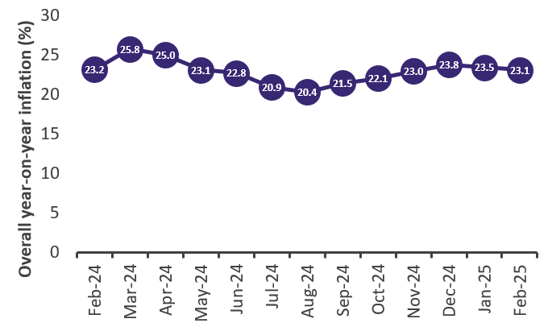
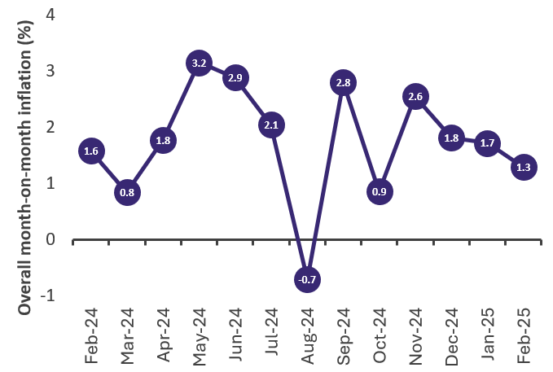
Overall Year-on-Year and Month-on-Month Inflation, February 2024 to February 2025
Notes:
Despite the further slow down in the rate on inflation in February 2025 (23.1%), it is the third highest in the last ten months as it levels up with the rate in May 2024.
Overall month-on-month inflation records a third consecutive month of a decline by halving the rate of inflation recorded in November 2024 (2.6%)

Slide 8
Disaggregation of February 2025 Rate of Inflation
28.1%
18.8%
28.3%
19.2%
1.8%
0.9%
7
25.1%
18.5%
Notes:
The difference between food (28.1%) and non-food inflation (18.8%) was 9.3 percentage points.
Both year-on-year and month-on-month food inflation increase in February 2025 by 0.2 and 0.4 percentage points respectively.
Month-on-month food inflation (1.8%) is higher than non-food inflation (0.9%) by 0.7 percentage points
The difference between inflation for locally produced items (25.1%) and imported items (18.5%) is 6.6 percentage points.

Slide 9
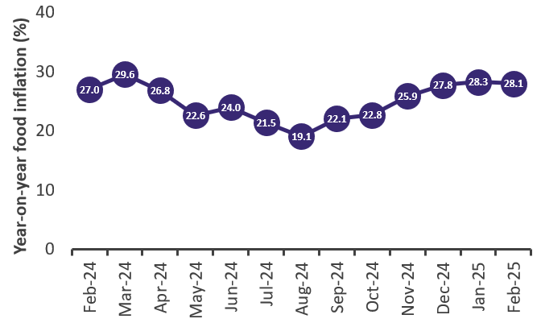
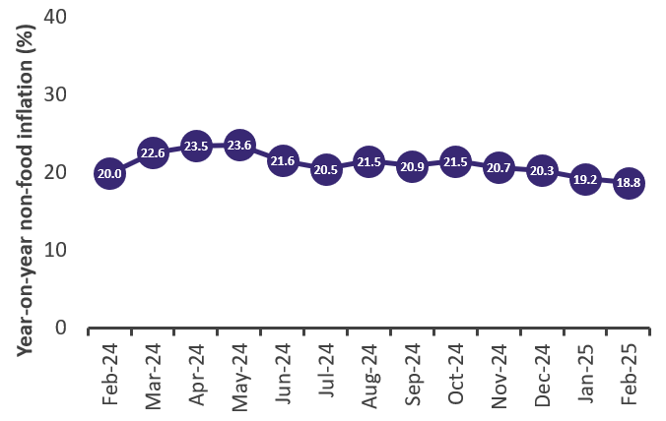
Food and Non-Food Year-on-year Inflation, February 2024 to February 2025
Notes:
Year-on-year food inflation decreases for the first time in the last five months though marginally.
Year-on-year non-food inflation slows down for the fifth consecutive month though marginally.

Slide 10
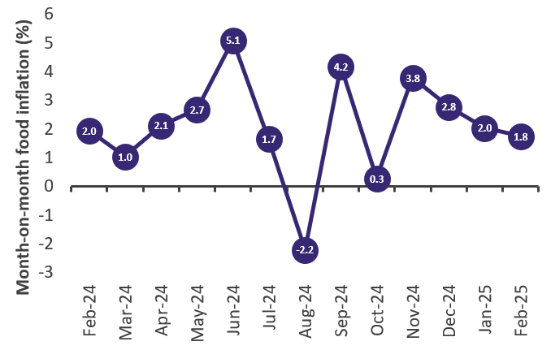
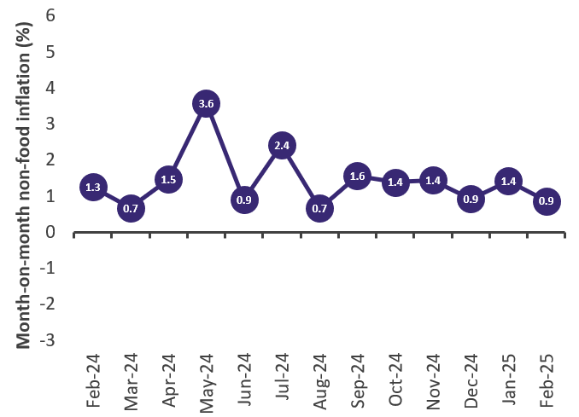
Food and Non-Food Month-on-month Inflation, February 2024 to February 2025
Notes:
Month-on-month food inflation recorded a disinflation for the third consecutive month with a drop by 1.0 percentage points between December 2024 and February 2025.
Month-on-month non-food inflation returns to a downward trend with a decrease of 0.6 percentage points between January 2025 and February 2025.

Slide 11
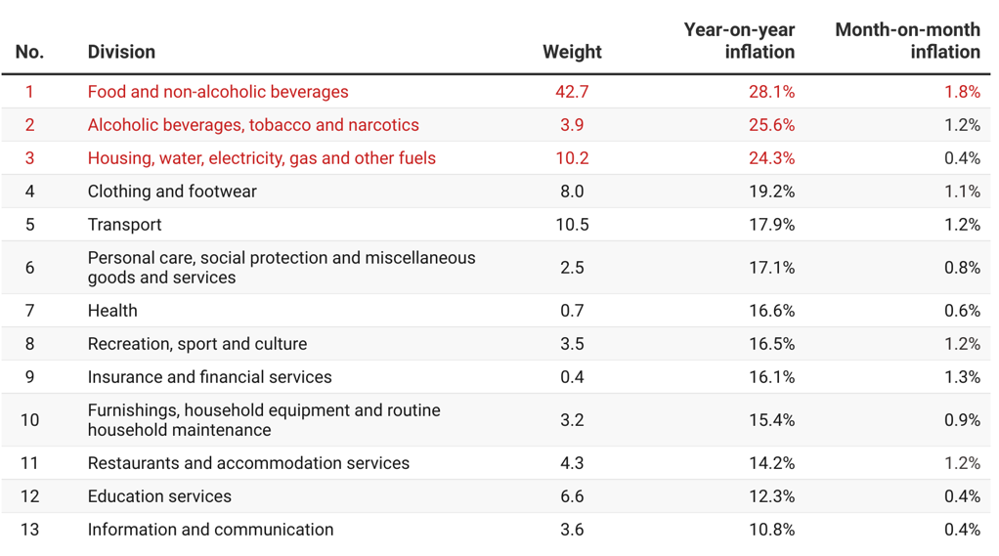
Disaggregation of February 2025 Year-on-year Inflation by Division
10
Notes:
Three divisions [Food and Non-Alcoholic Beverages (28.1%); Alcoholic beverages, tobacco and narcotics (25.6%); and Housing, water, electricity, gas and other fuels (24.3%)] recorded year-on-year rates of inflation higher than the overall inflation (23.1%).
Only one division Food and Non-Alcoholic Beverages (1.8%) recorded month-on-month inflation rate higher than the overall rate (1.3%).

Slide 12
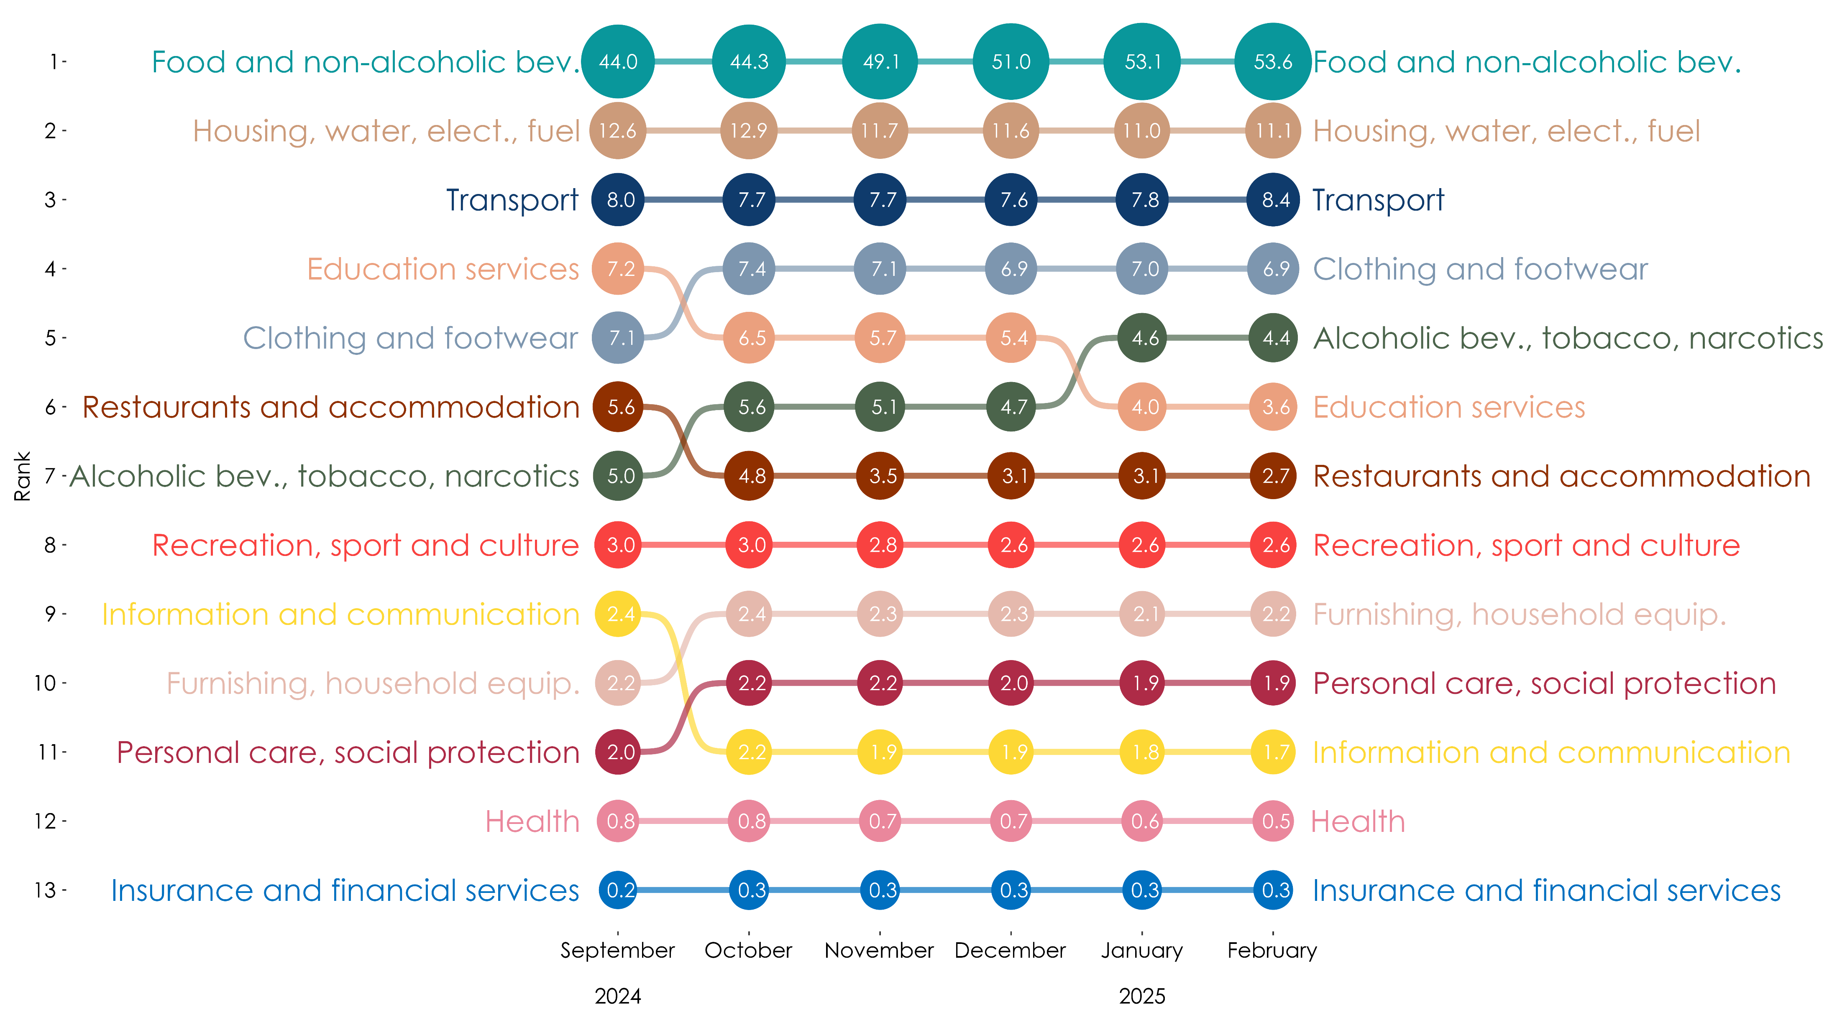
Share of February 2025 Year-on-Year Inflation Across Divisions
11
Notes:
The share of food and non-alcoholic beverages is more than half (53.6%) for the third consecutive month.
Four divisions (Food and Non-Alcoholic Beverages, Housing, Water, Electricity, Gas and Other Fuels, Transport and Clothing and Footwear) had a share of exactly four-fifths (80.0%) of annual inflation in January 2025.

Slide 13
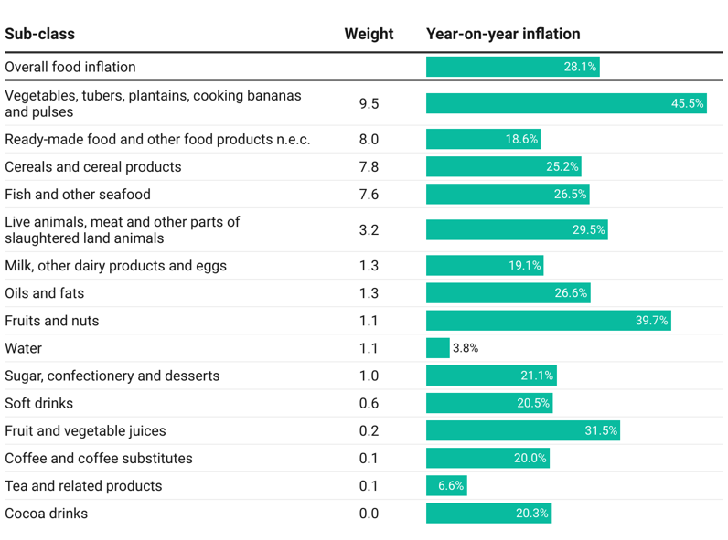
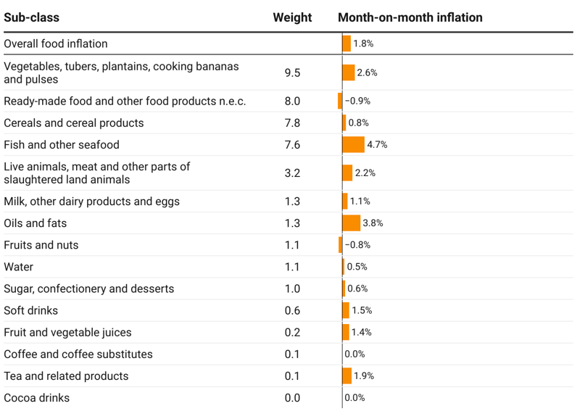
Disaggregation of YoY and MoM Food Inflation by Sub-class
Notes:
Vegetables, Tubers and Plantains were the main drivers of both annual (4.3 percentage points of the overall annual food inflation of 28.1%) and monthly food inflation (0.2 percentage points of the overall monthly food inflation of 1.3%)

Slide 14
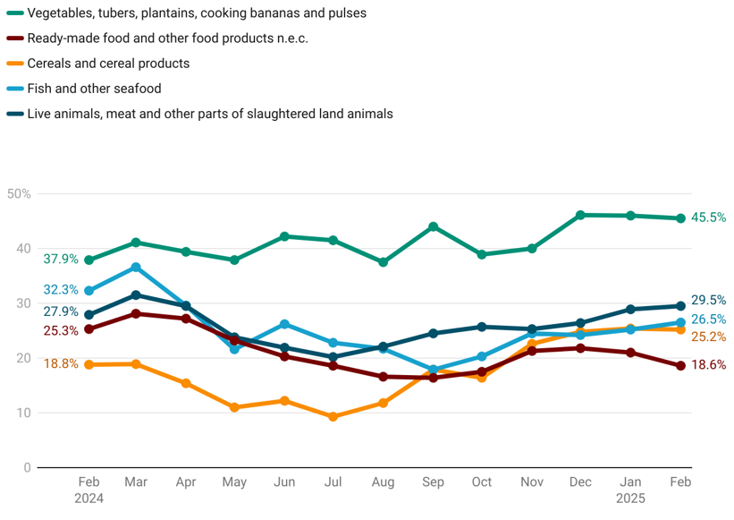
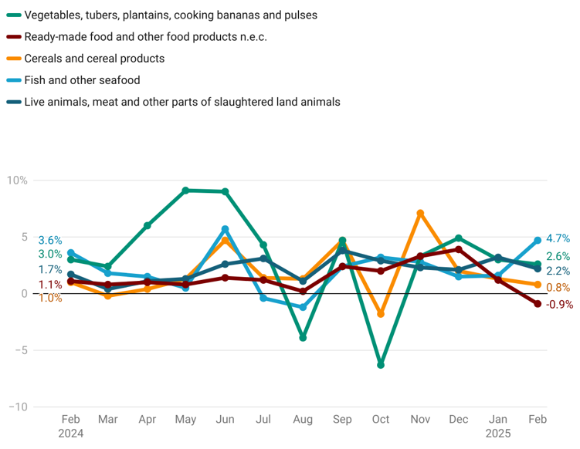
Disaggregation of YoY and MoM Food Inflation by Sub-class
Year-on-year
Rank | Weight
1 | 9.5
2 | 8.0
3 | 7.8
4 | 7.6
5 | 3.2
Month-on-month
13
Notes:
Annual inflation rates for Vegetables, Tubers and Plantain of 45.5 percent retains its dominance as the driver of food inflation.

Slide 15
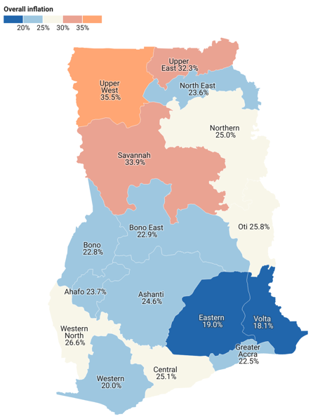
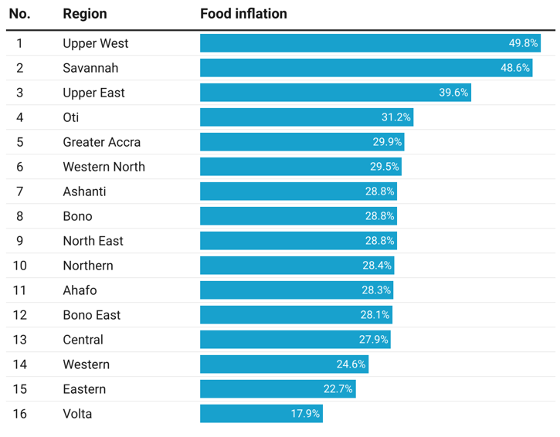
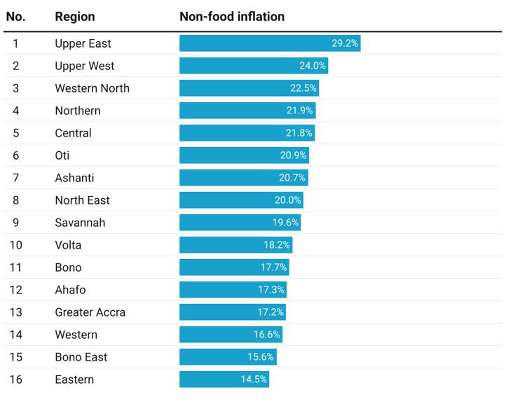
Regional Rates of Inflation for February 2025
14
Notes:
Upper West Region (35.5%) recorded the highest rate of inflation and Volta Region the lowest (18.1%).
Nine regions [Upper West (35.5%); Savannah (33.9%); Upper East (32.3%); Western North (26.6%); Northern (25.0%); Oti (25.8%); Central (25.1%); and Ashanti (24.5%)] recorded inflation rates higher than the overall (23.1%).
Upper West Region(49.9%) recorded the highest food inflation which was about 2.7 times as high as the rate recorded in Volta Region which had the lowest rate (18.0%)
Upper East Region (32.7%) recorded the highest non-food inflation which was more than 2.6 times as high as the rate for Bono East (12.5%), the lowest.

Slide 16
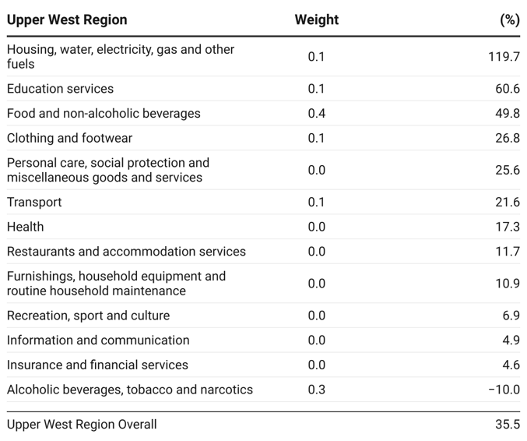
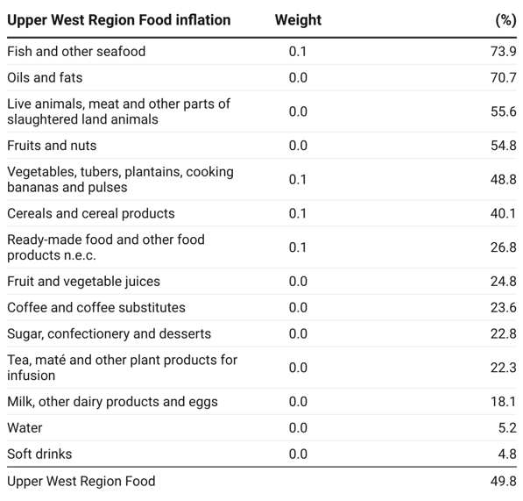
Disaggregation of Overall Inflation and Food Inflation in Upper West Region
15
Notes:
In the Upper West Region, three divisions [Housing, Water, Electricity, Gas and Other Fuels (119.7%); Education Services (60.6%) and Food and Non-Alcoholic beverages (49.8%) recorded a rate of inflation higher than the regional overall rate (3%).
Also in the Upper West Region, four sub-classes of food, which was led by Fish and Other Seafoods (73.9%) recorded rates higher than the Region’s overall food inflation of 49.8% percent.

Slide 17
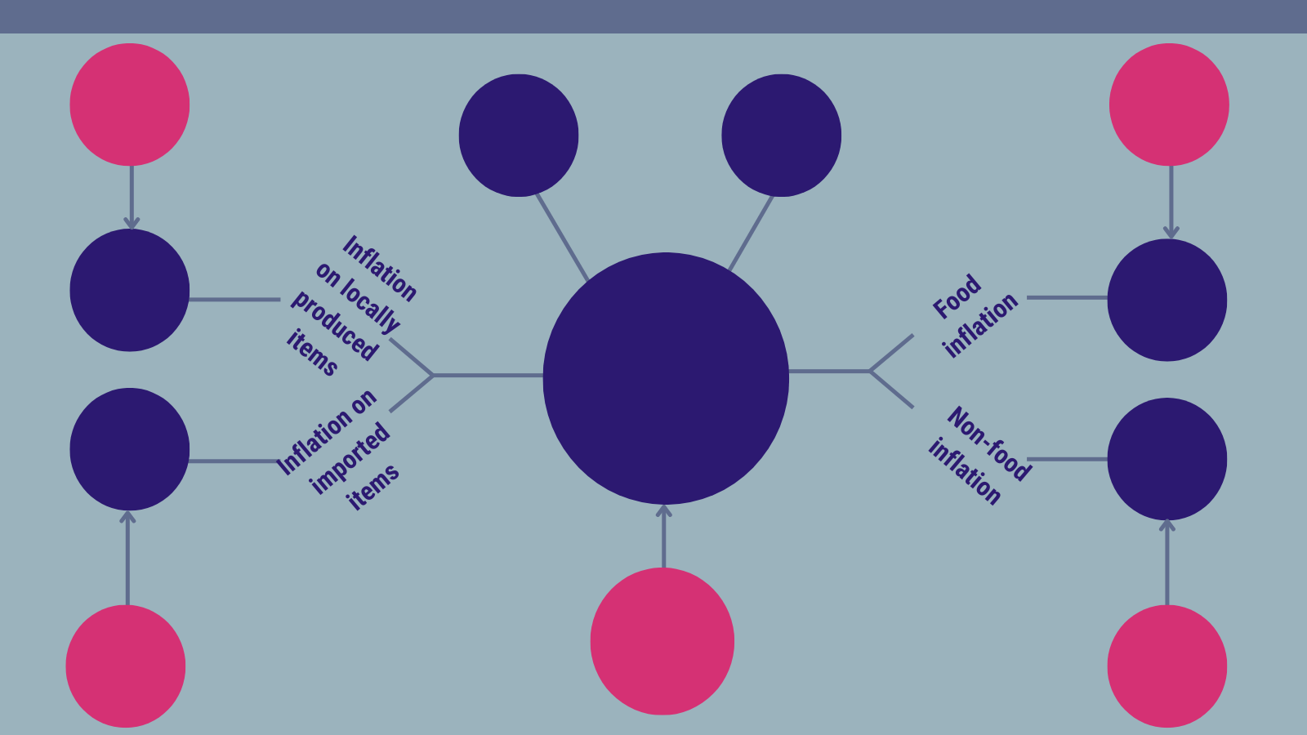
Highlights for February 2025 Rates of Inflation (1/2)
25.7%
Inflation on locally produced items
January 2025
28.3%
Food inflation
January 2025
35.5%
Highest regional inflation rate
(Upper West)
18.1%
Lowest regional inflation rate
(Volta)
25.1%
28.1%
23.1%
Year-on-year inflation
February 2025
18.5%
18.8%
23.5%
Year-on-year inflation
January 2025
18.4%
Inflation on imported items January 2025
19.2%
Non-food inflation
January 2025
Notes:
Year-on-year consumer rate of inflation for February 2025 was 23.1 percent representing a 0.4 percentage point decrease relative to the rate recorded in February 202y (23.1%).

Slide 18
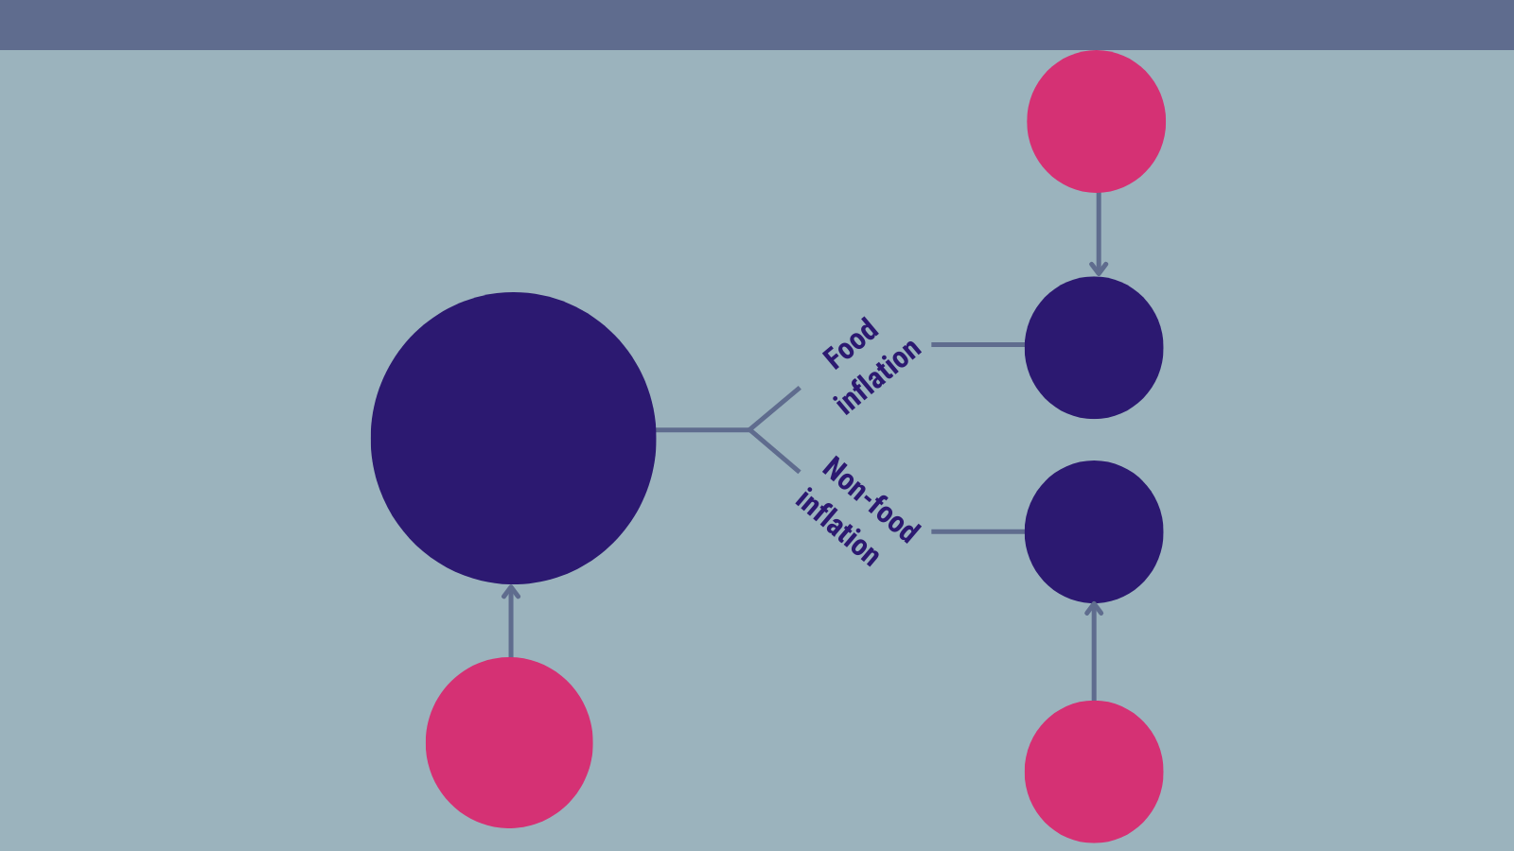
Highlights for February 2025 Rates of Inflation (2/2)
2.0%
Food inflation
January 2025
1.8%
1.3%
Month-on-month inflation
February 2025
0.9%
1.7%
Month-on-month inflation
January 2025
1.4%
Non-food inflation
January 2025
Notes:
Overall month-on-month inflation drops decreased by 0.4 percentage points from 1.7 percent to 1.3 percent in February 2025...
Month-on-month food inflation decreased by 0.2 percentage points from 2.0 percent to 1.8 percent in February 2025.
Month-on-month non-food inflation decreases by 0.5 percentage points from 1.4 percent to 0.9 percent in February 2025.

Slide 19
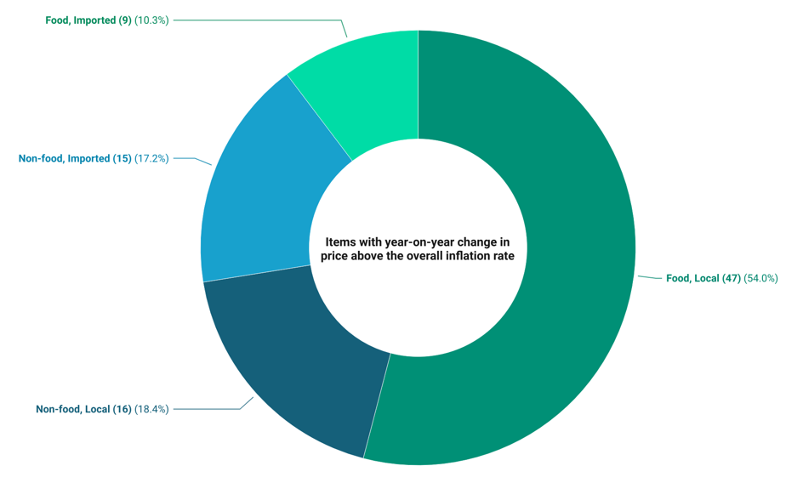
Items with Price Changes Higher than the Overall Rate of Inflation
18
Notes:
Over a quarter (87) of the items recorded prices higher than the national rate of inflation (23.1%). This was dominated by local food items (47) and followed by imported non-food items (16 items).

Slide 20
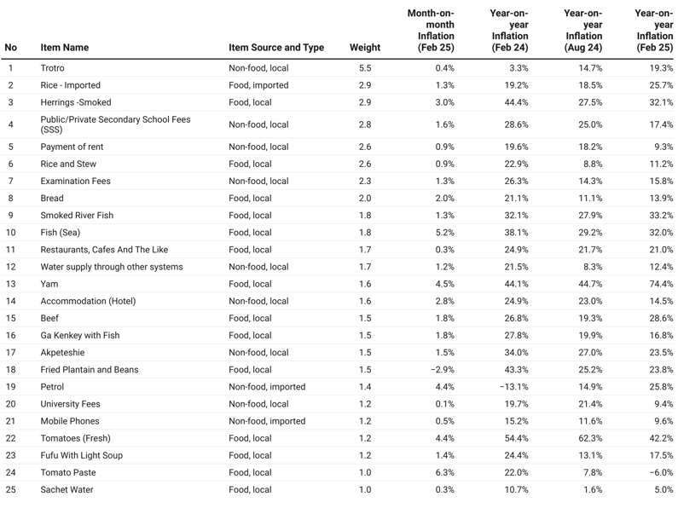
Price Changes of Items with Weights => One
19
Notes:
In the list of the top 25 items with significant weights that is greater than one, Yam and Fresh Tomatoes recorded the highest upward price changes for both year-on-year and month-month with 72.9 percent and 4.7 percent, and 43.3 percent and 6.5 percent, respectively.

Slide 21
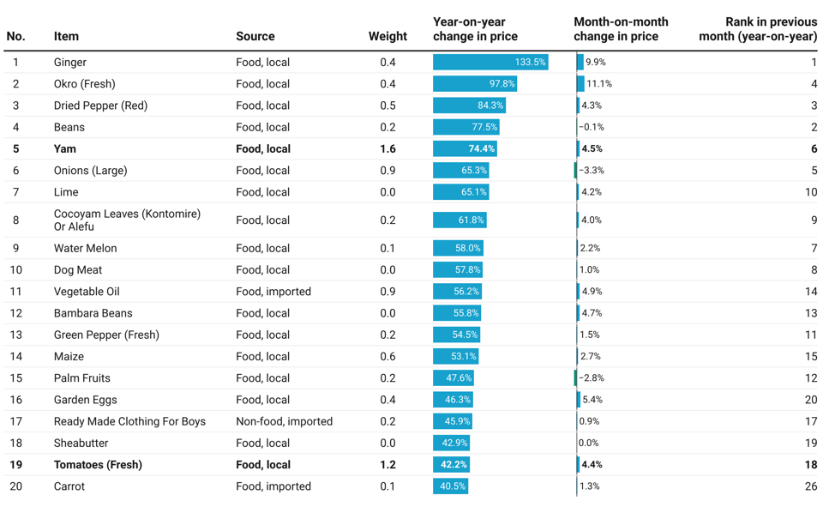
National and Household-Level Issues for Wider Engagement
Notes:
Ginger, Okro(Fresh) and Dried Pepper (Red) were the top three items that recorded a highest year-on-year price changes of 133.5 percent, 97.8 percent and 84.3 percent respectiviely.
Fresh Okro (11.1%) recorded the highest month-on-month price increases followed by Ginger (9.9%) and Garden Eggs (5.4%).
The only two items with significant weight in the list of the top 20 items with the highest price increases are Yam (1.6) Fresh Tomatoes (1.2), which recorded respective upward price changes of 74.4 percent and 42.2 percent.

Slide 22
End of Press Release for February 2025 Consumer Price Index
For enquiries, please contact:
Mr. J. F.K. Agyaho
(Head, Price Statistics, GSS)
john.agyaho@statsghana.gov.gh
Download the technical guide:
https://statsghana.gov.gh/gssmain/fileUpload/Price%20Indices/CPI_Technical_Guide_v5_Published_14102020.pdf

Slide 23
Consumer Price Index and Inflation
February 2025

